Slide 1
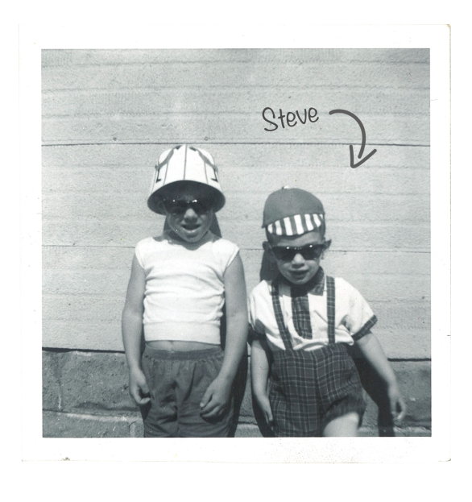

Slide 4
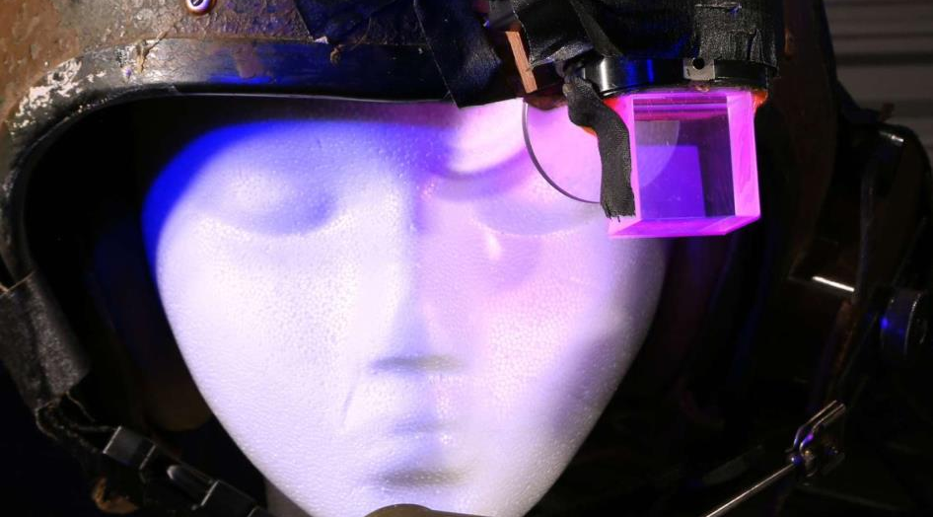
Mann’s Digital Eye Glass
1978-1980

Slide 5
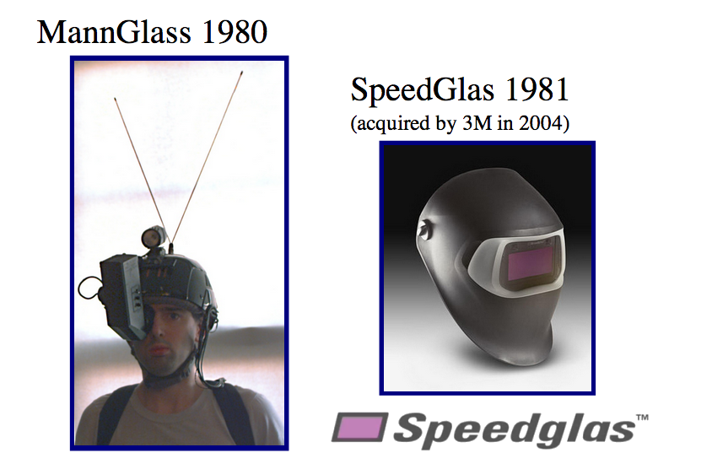

Slide 6
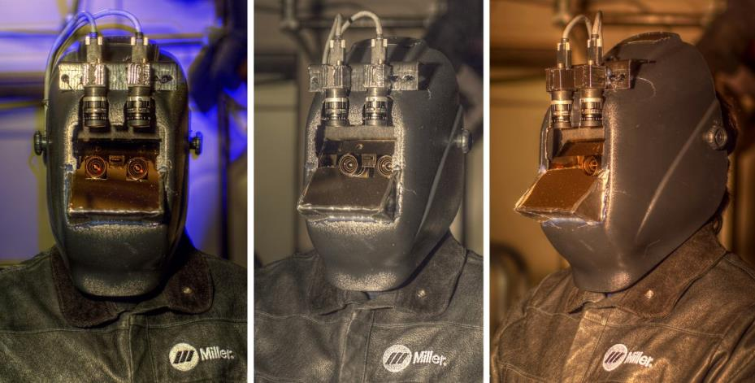

Slide 7
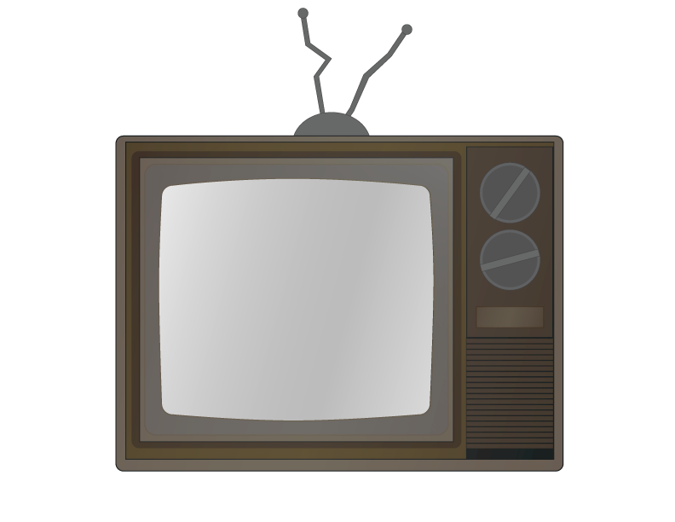
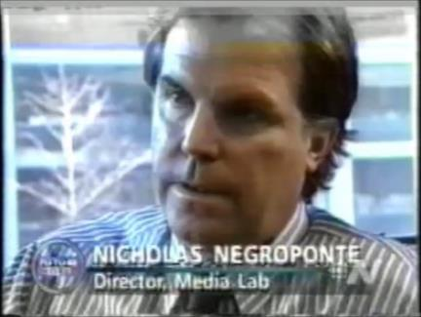

Slide 9
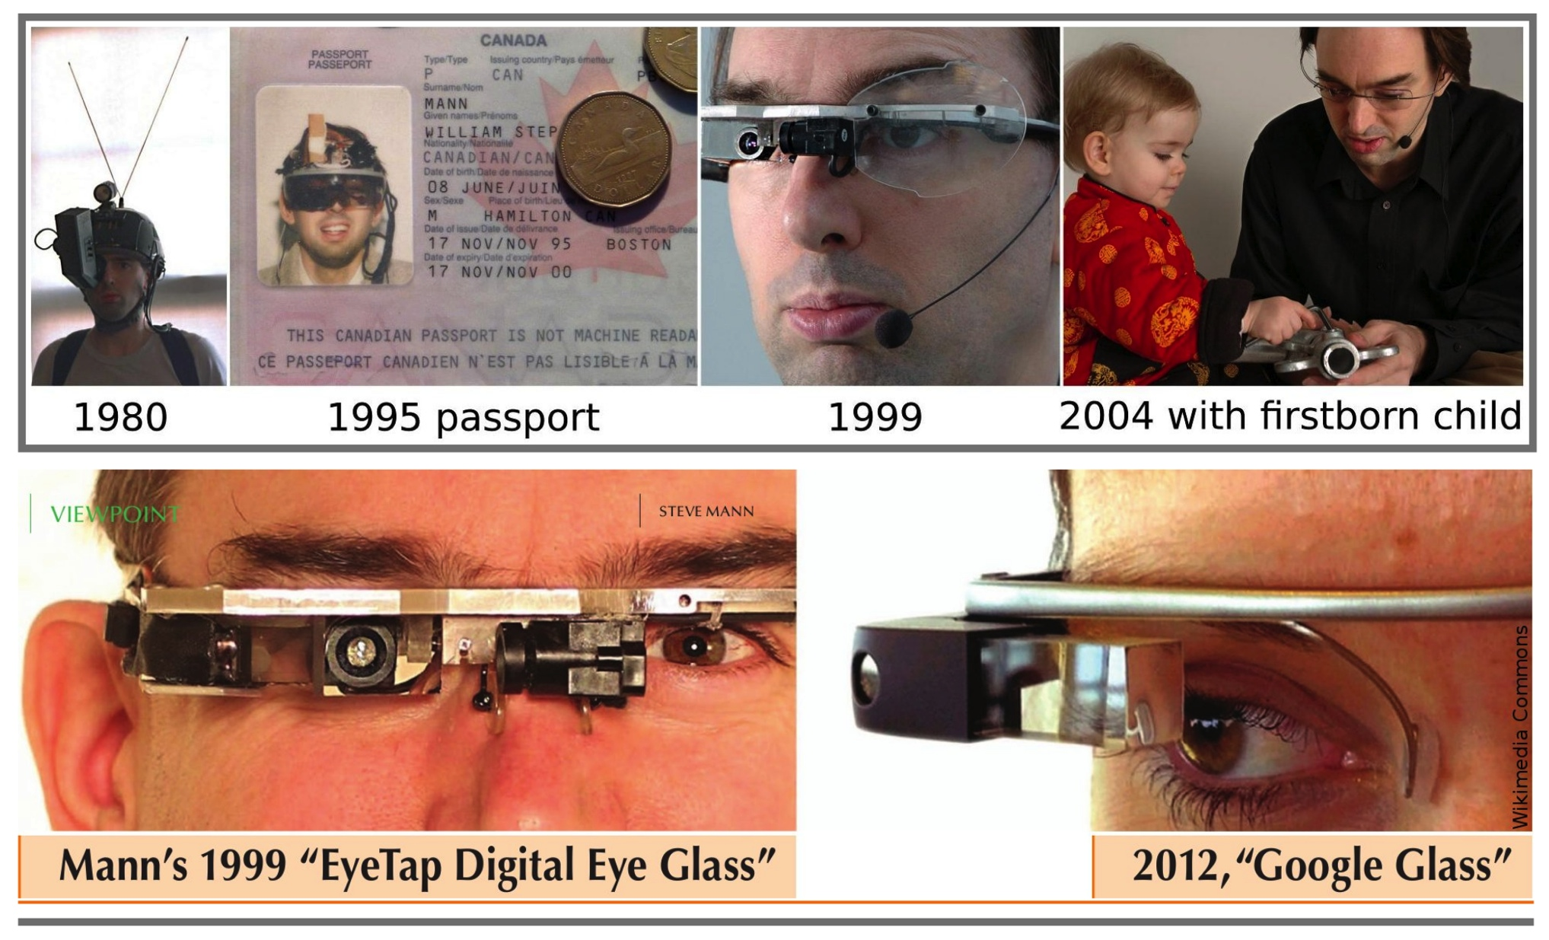

Slide 10
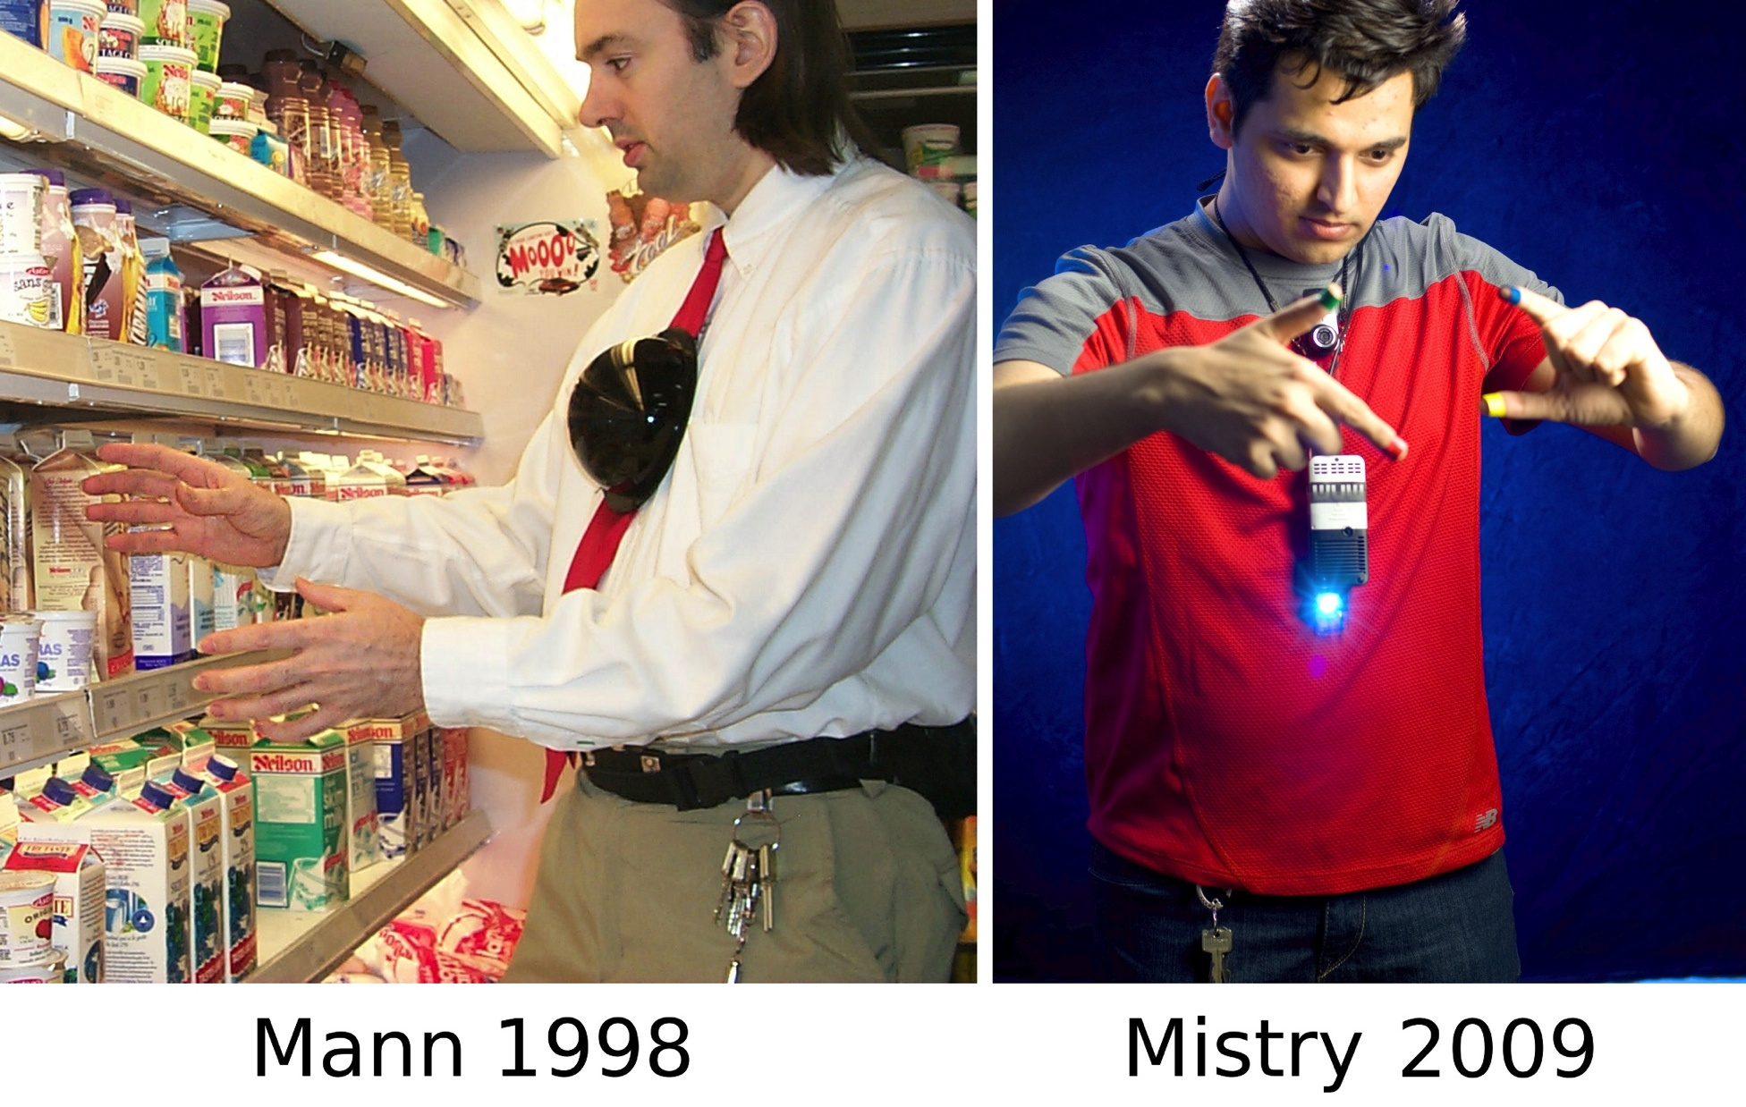

Slide 11
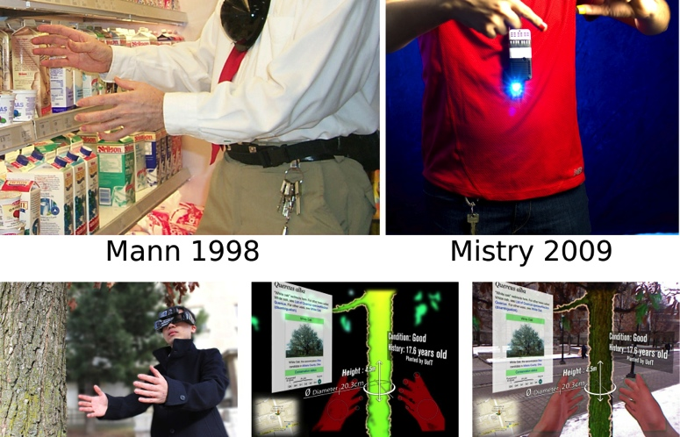

Slide 13
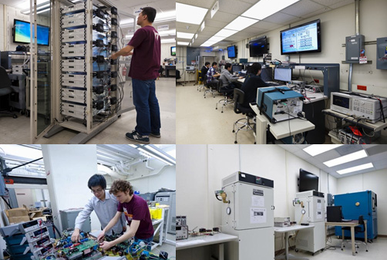
cpes.vt.edu

Slide 15
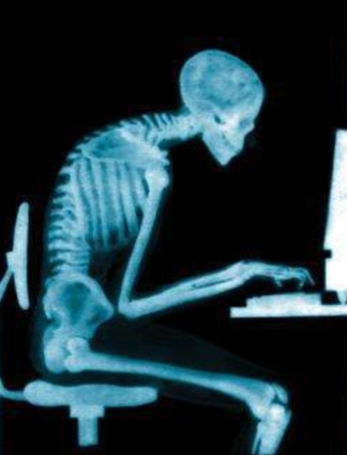
http://gokaleo.com/

Slide 16
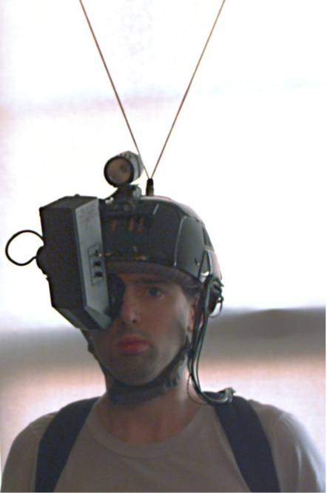

Slide 17
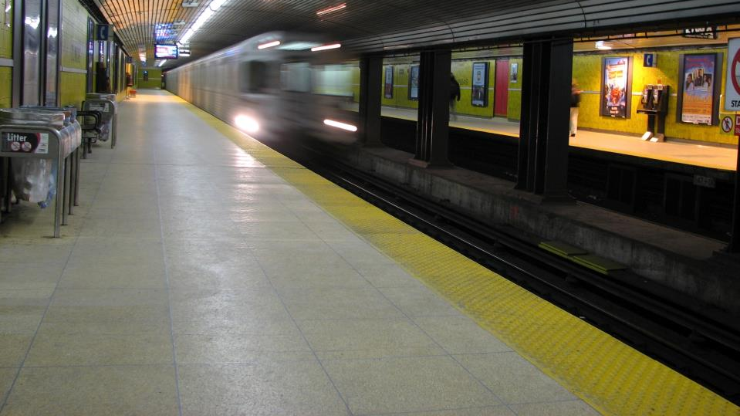
wikimedia.org

Slide 18
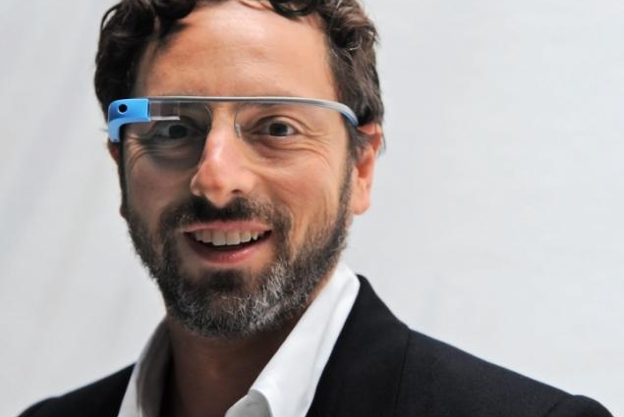
http://assets.nydailynews.com/

Slide 20
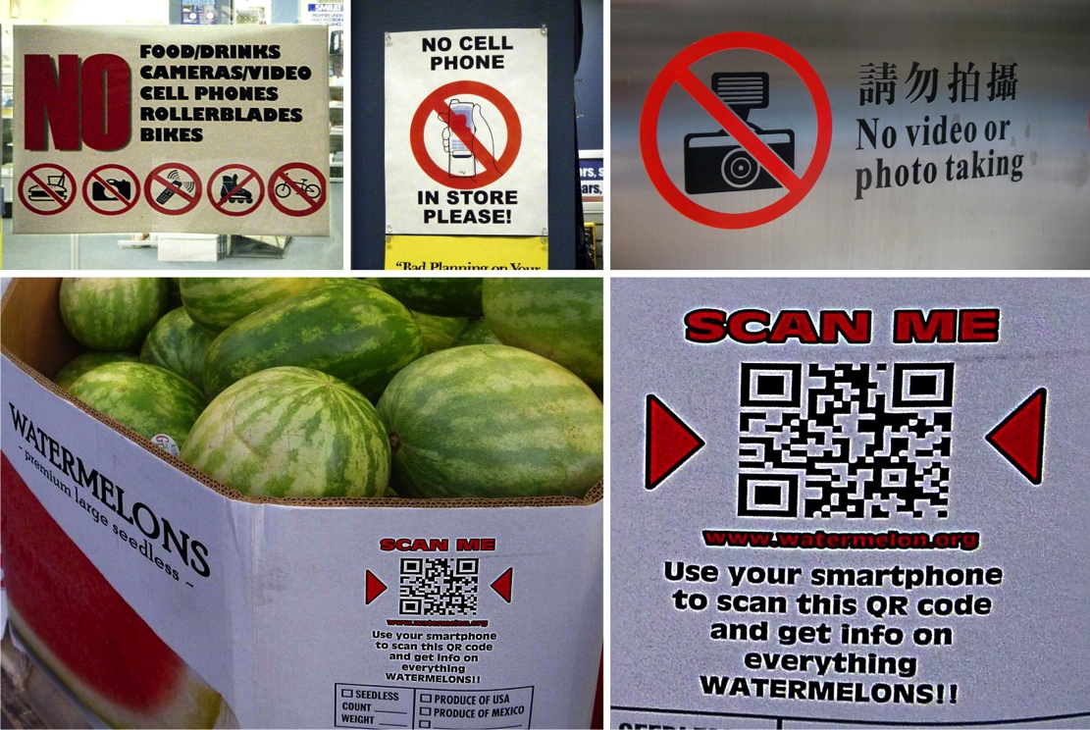

Slide 21
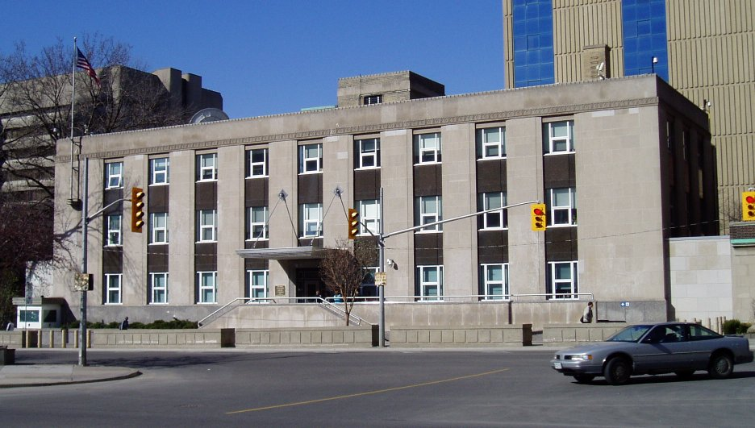
wikimedia.org

Slide 22
“SURVEILLANCE CAMERAS ARE NOT CAMERAS!”

Slide 23
sur·veil·lance (sərˈveɪ ləns) n. a watch kept over someone or something, esp. over a suspect, prisoner, etc.: The suspects were under police surveillance. Random House Dictionary © 2013

Slide 24
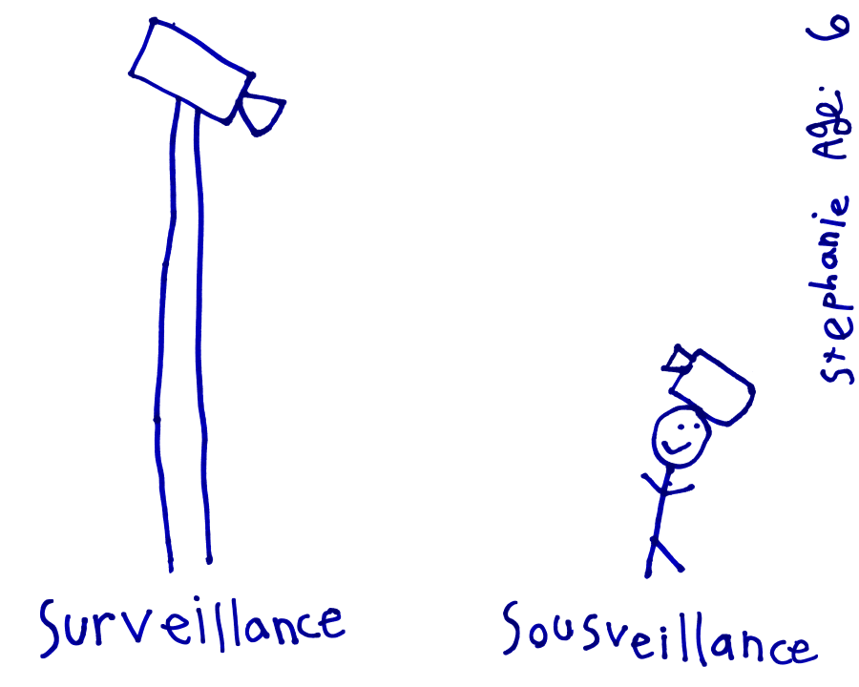

Slide 26
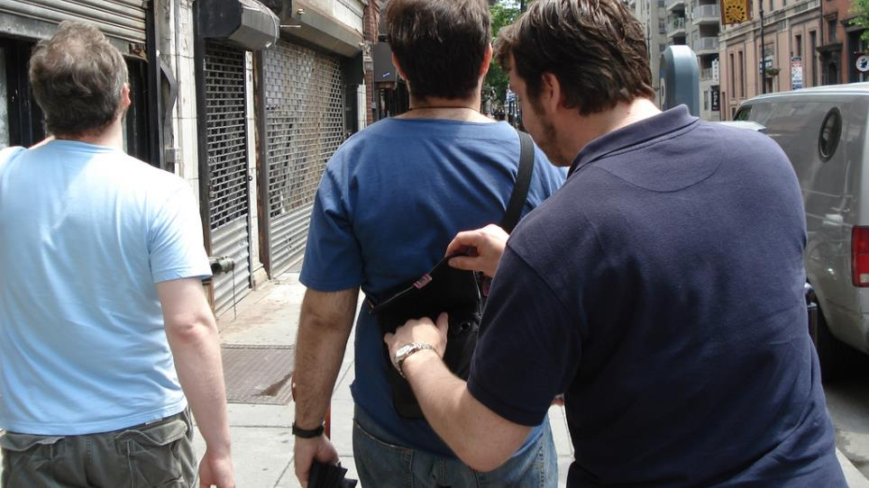
http://www.travelsupermarket.com/

Slide 27
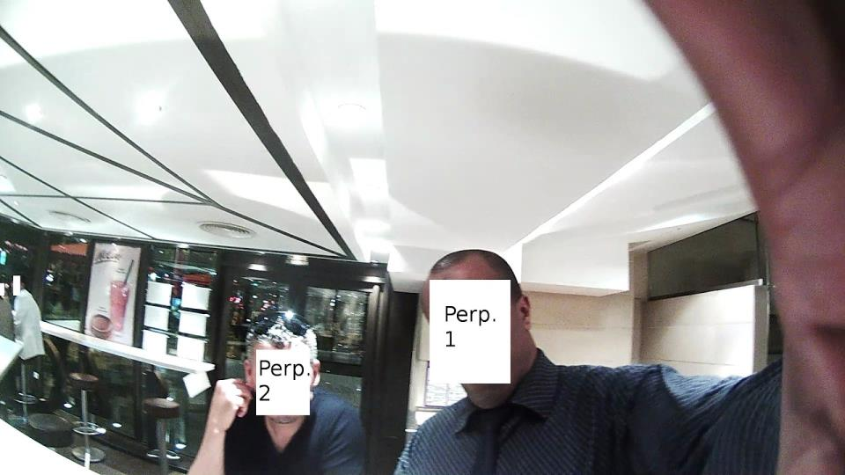

Slide 28
HYPOCRISY

Slide 29
HYPOCRISY
INTEGRITY

Slide 30
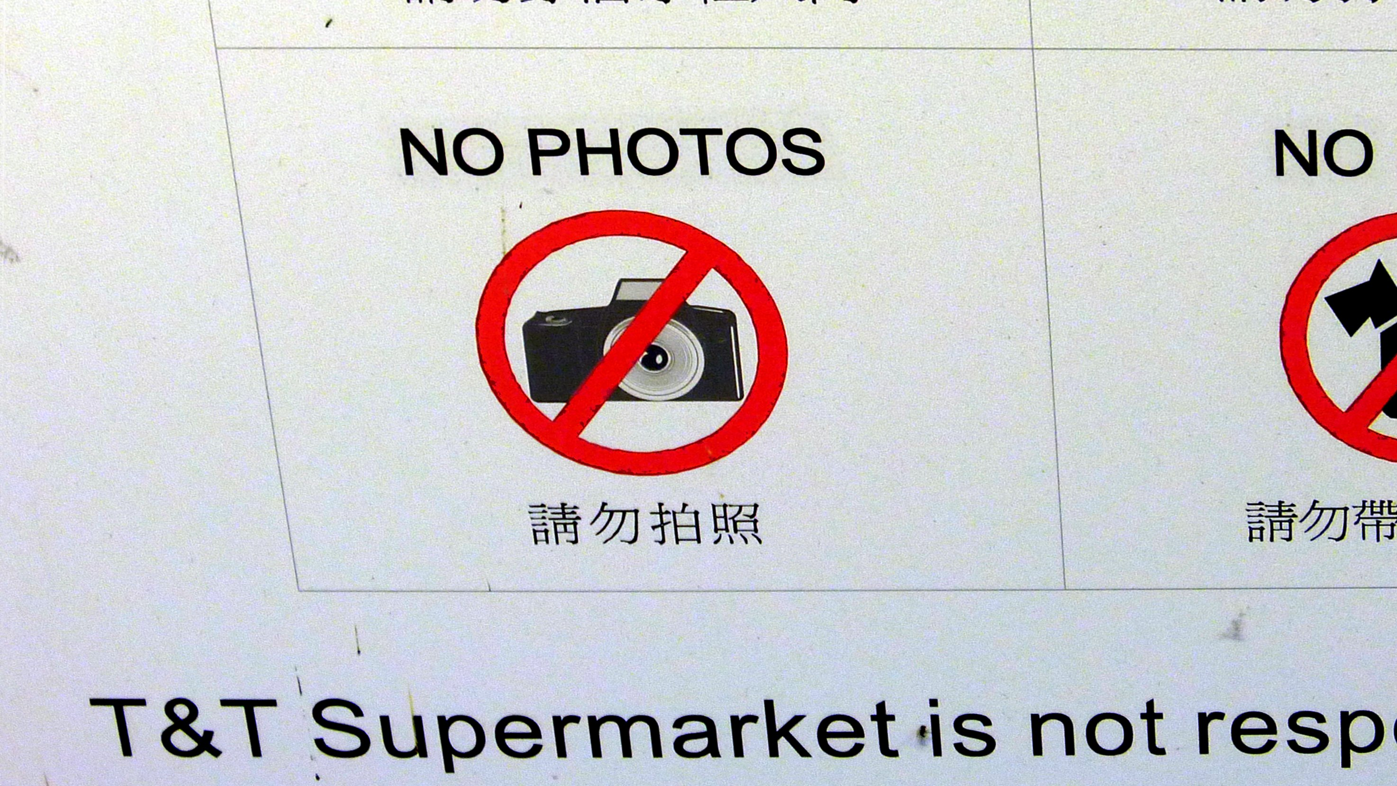

Slide 31
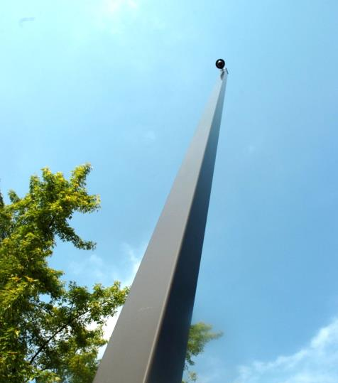
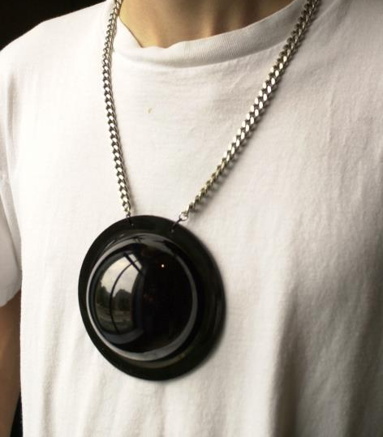
Surveillance
Sousveillance

Slide 32
THE VEILLANCE CONTRACT: AN INTEGRITY PROTOCOL FOR THE CYBORG AGE

Slide 33
HYPOCRISY
CENTRALIZED
DISTRIBUTED
INTEGRITY

Slide 34
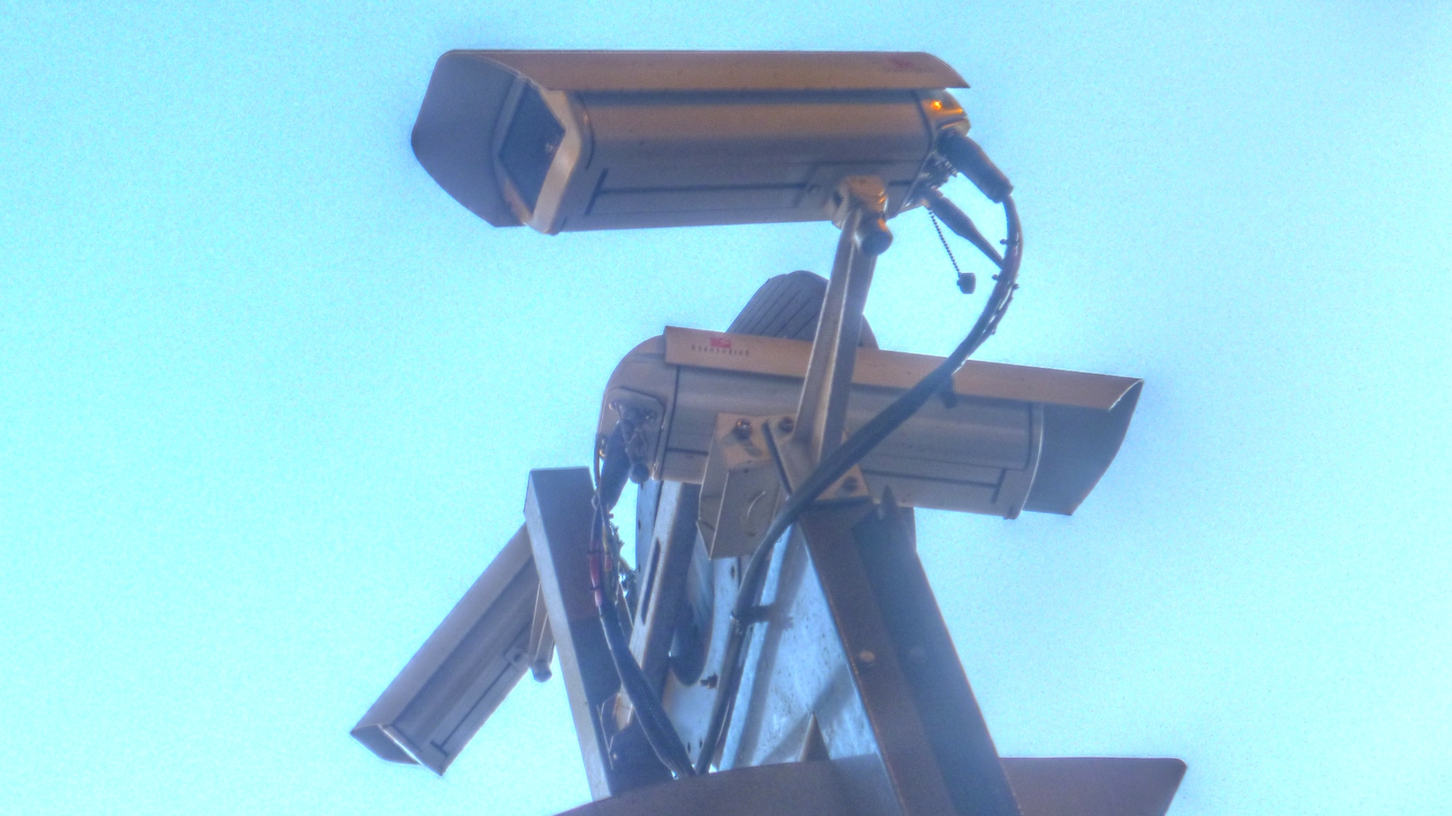

Slide 35
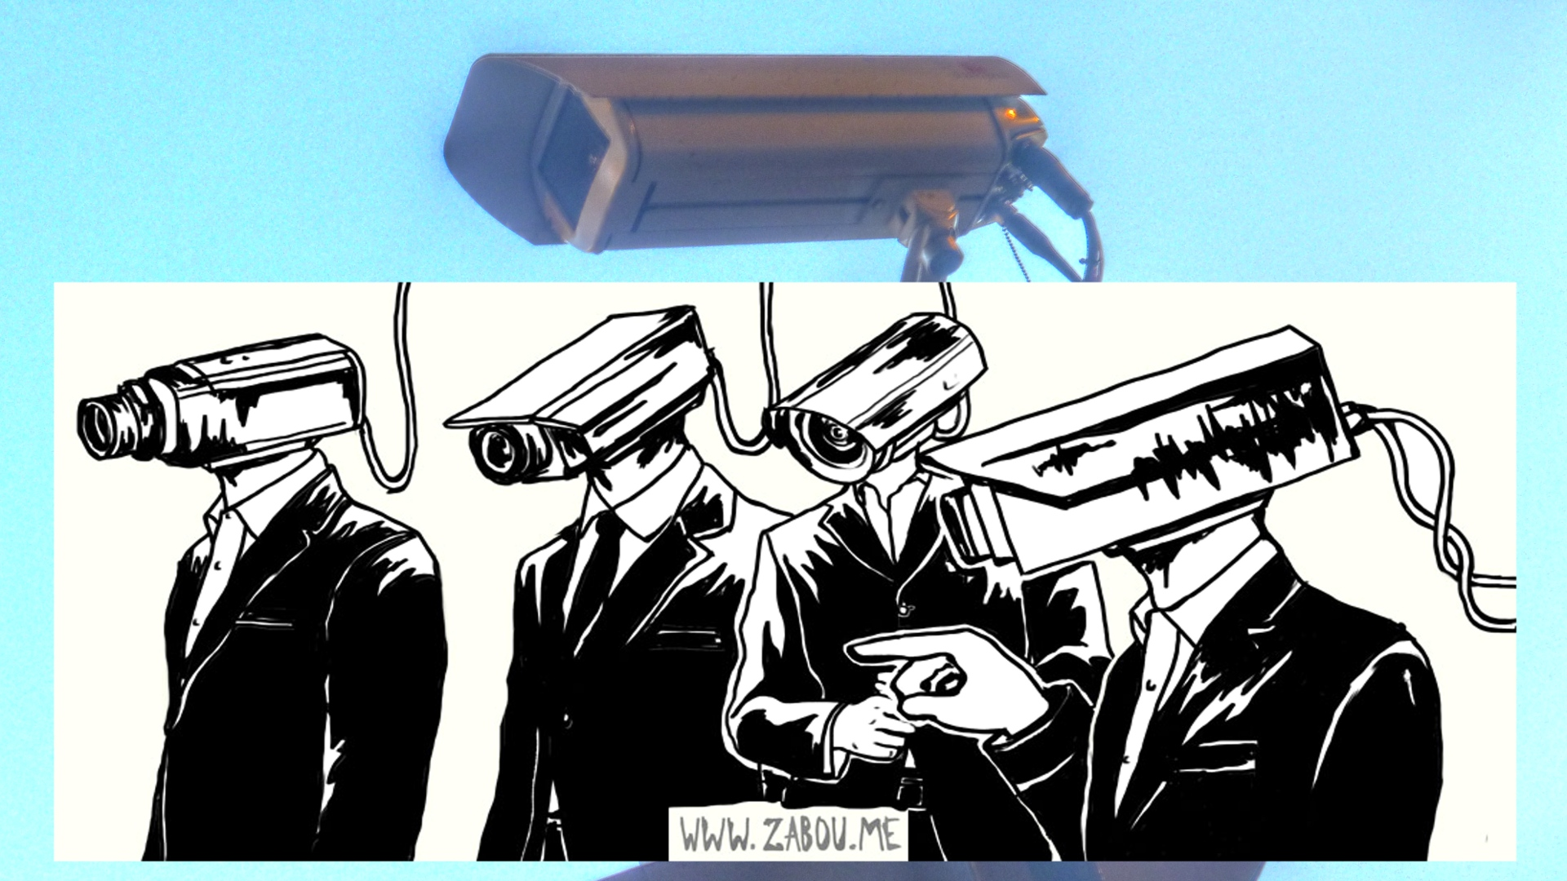

Slide 36
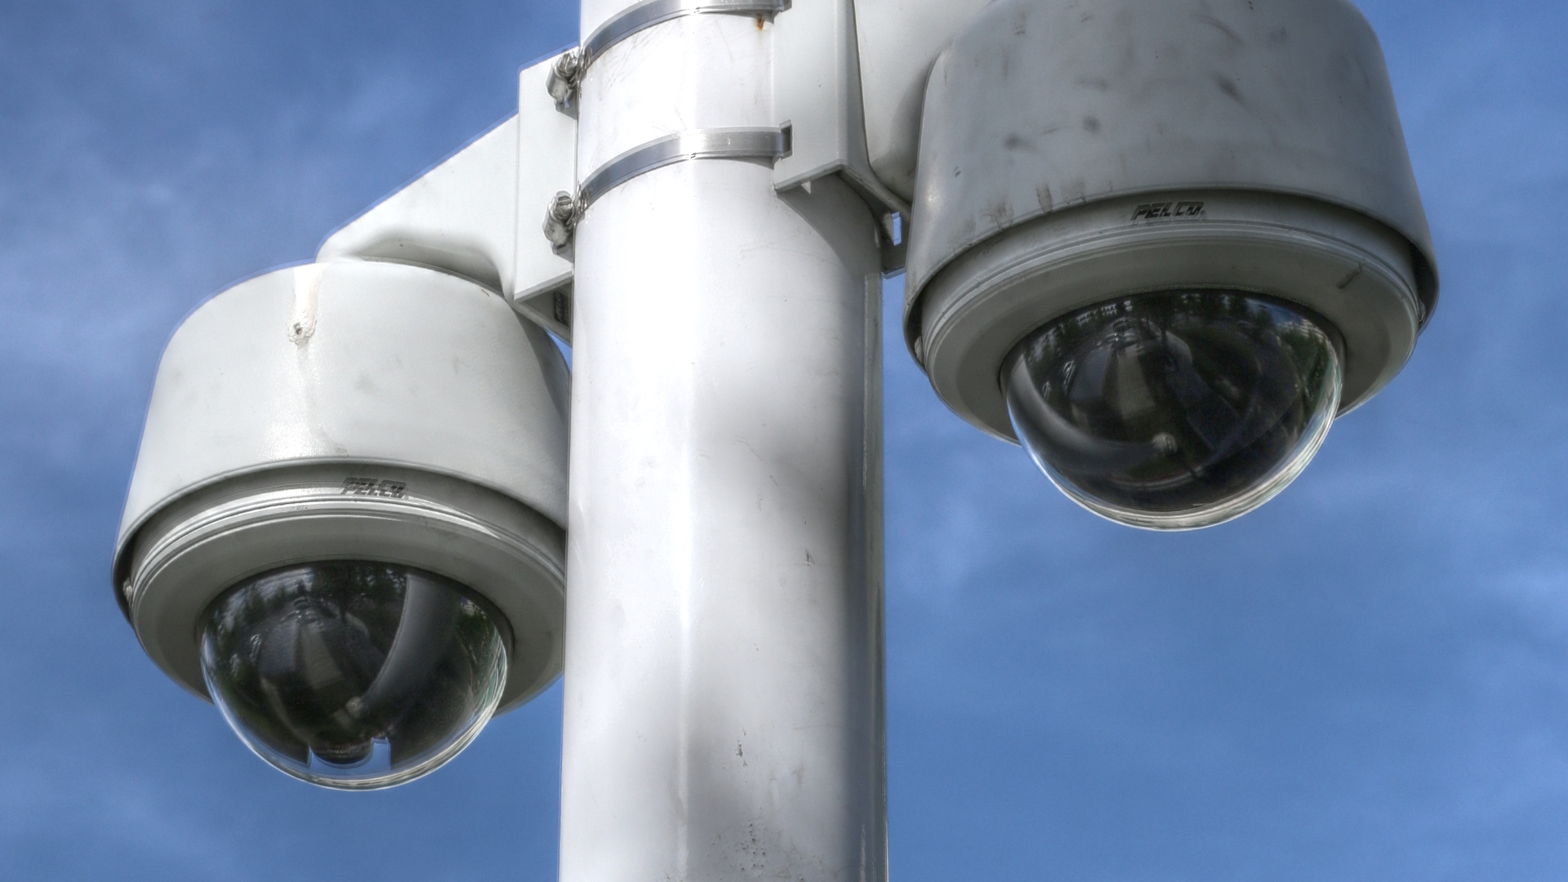

Slide 37
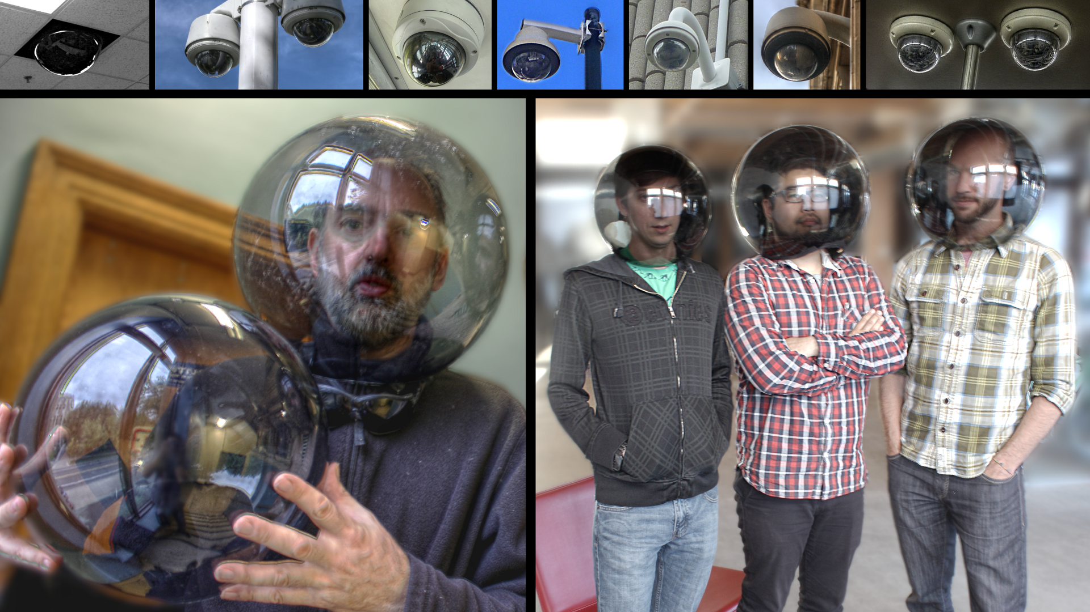

Slide 38
HYPOCRISY
CENTRALIZED
OPENNESS
SECRECY
DISTRIBUTED
INTEGRITY

Slide 40
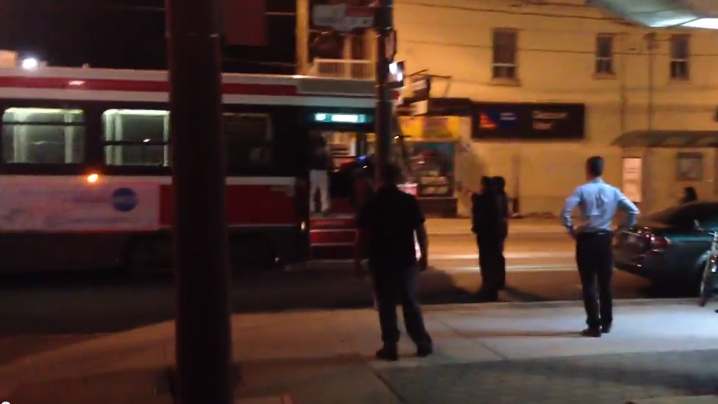
Marko G/YouTube

Slide 41
