Slide 1
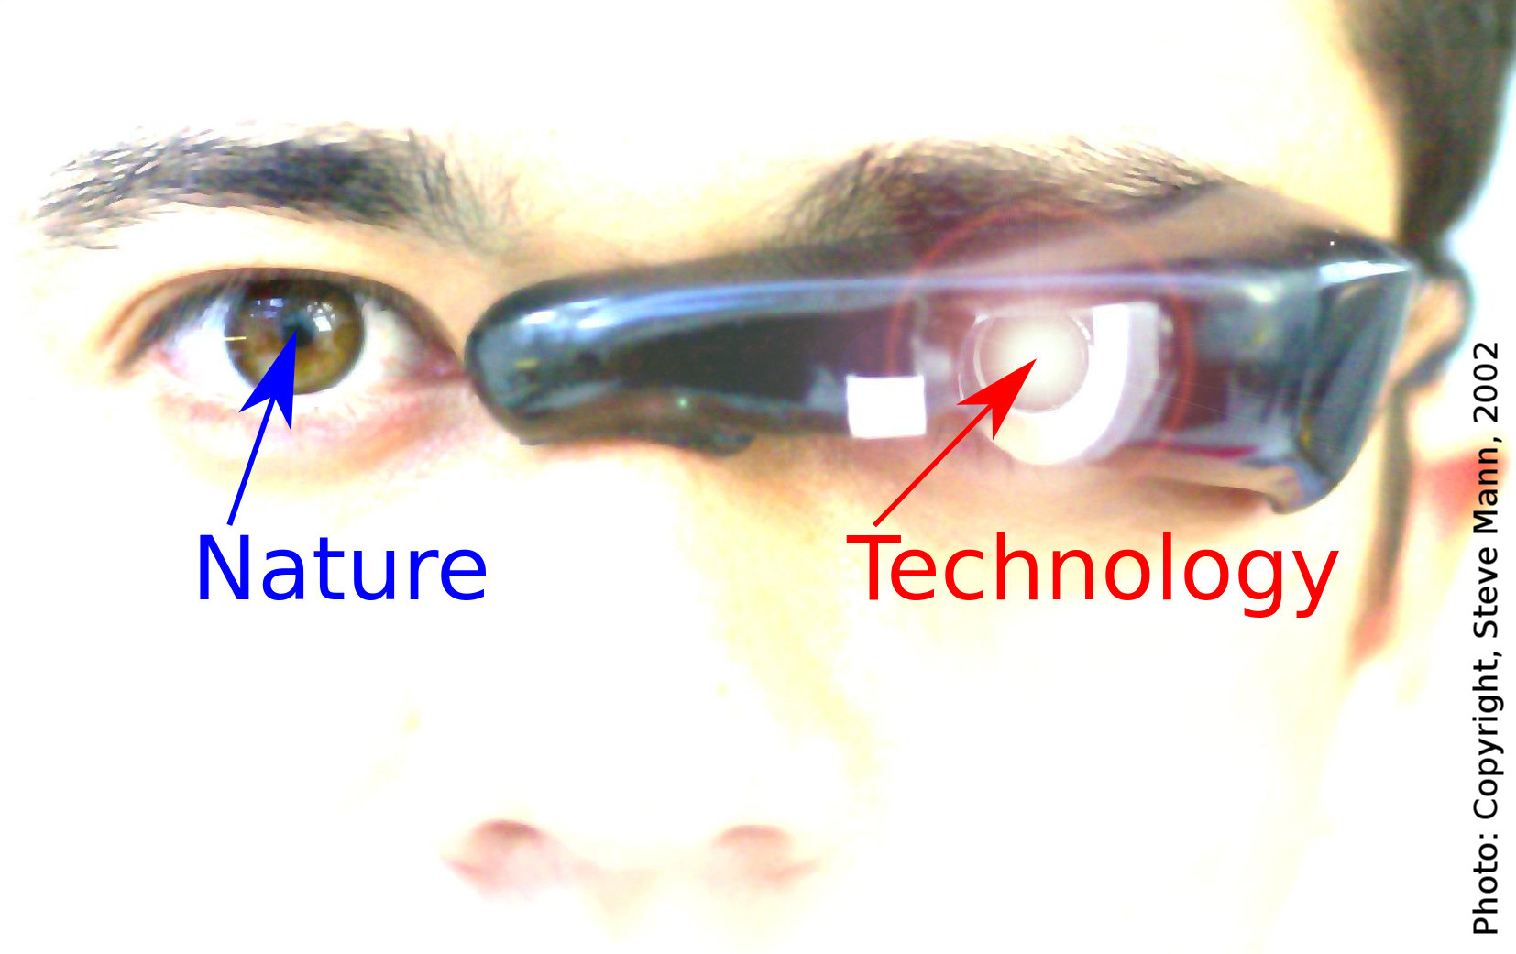
Humanistic Intelligence
Tuesday December 15 2015
Steve Mann, Chief Scientist, Meta

Slide 2
“Humanistic Intelligence [HI] is intelligence that arises because of a human being in the feedback loop of a computational process, where the human and computer are inextricably intertwined. When a wearable computer embodies HI … [it] gives rise to superhuman intelligence”
— Kurzweil, Minsky, and Mann, “The Society of
Intelligent Veillance”, IEEE ISTAS 2013.

Slide 3
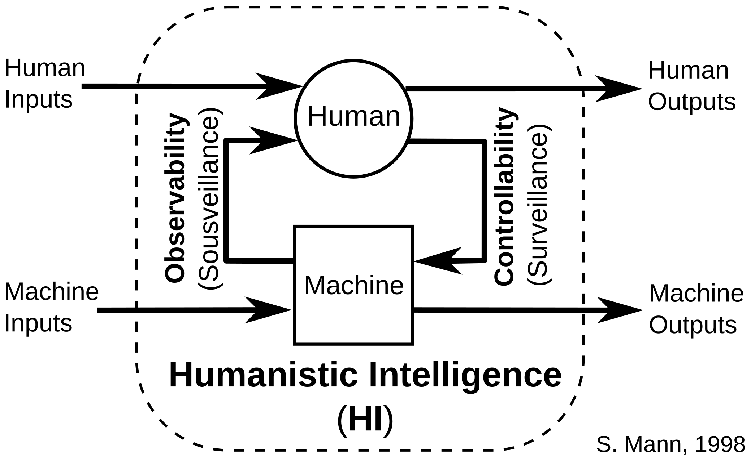

Slide 4
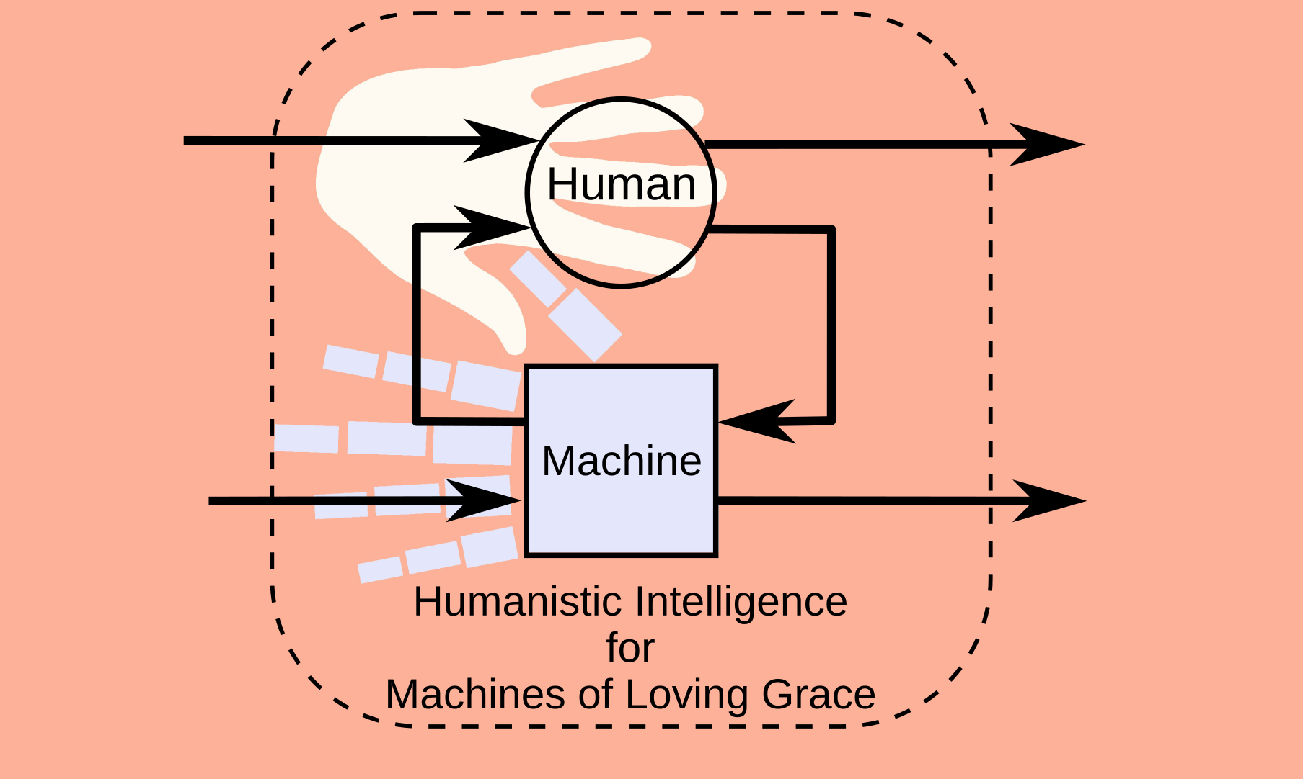
Hands Image from Book Cover, Machines of Loving Grace: The Quest for Common Ground Between Humans and Robots by John Markoff

Slide 5
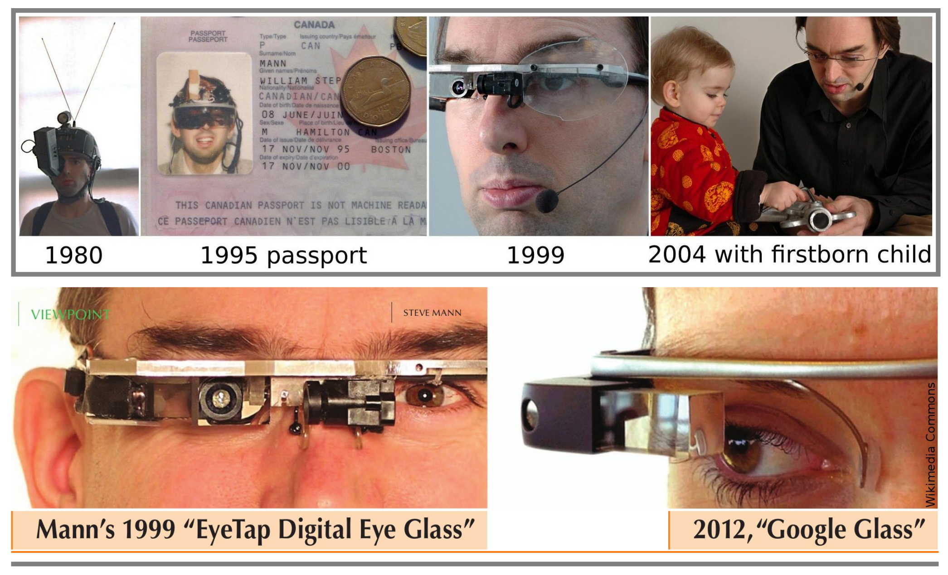

Slide 6
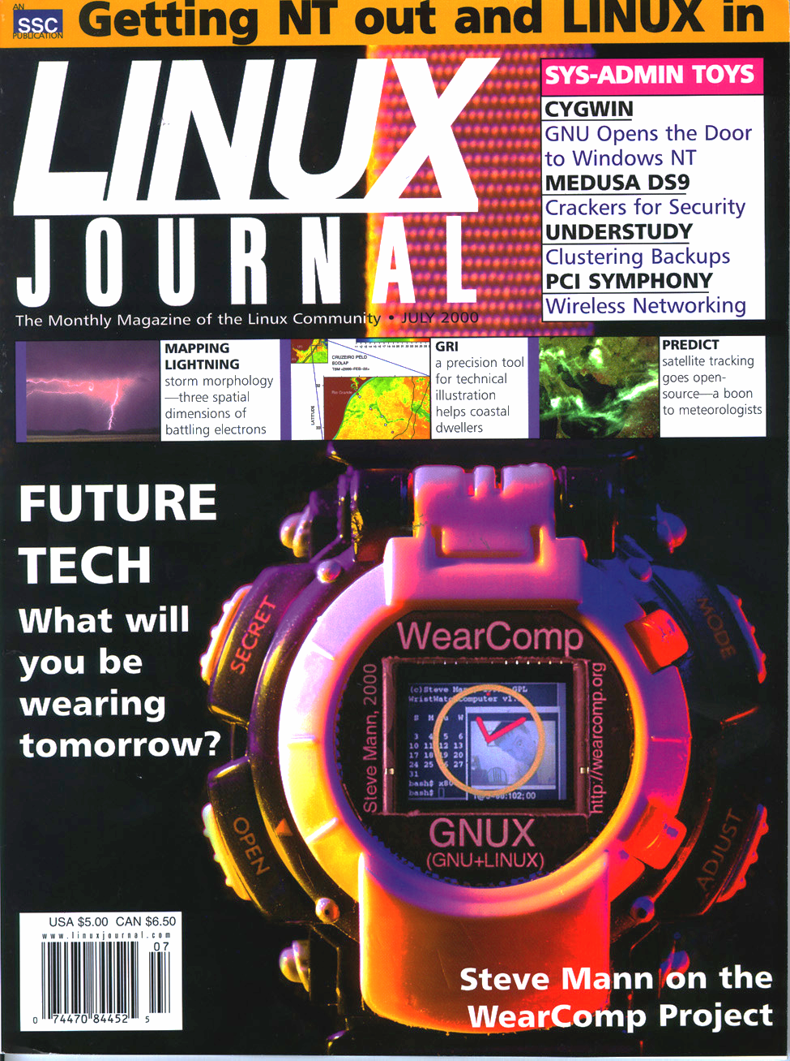
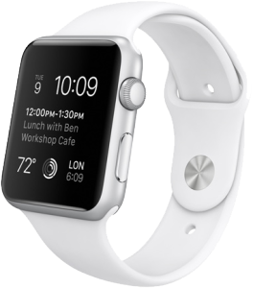
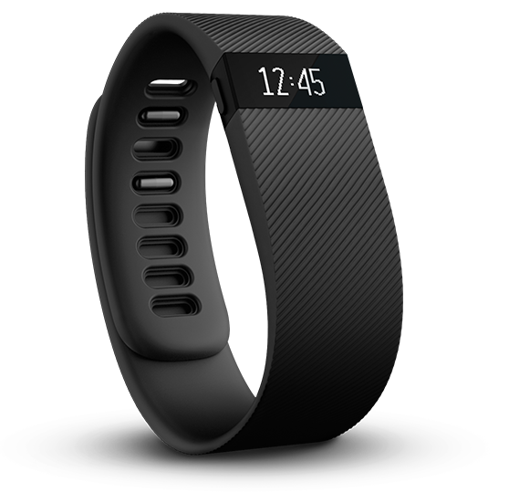
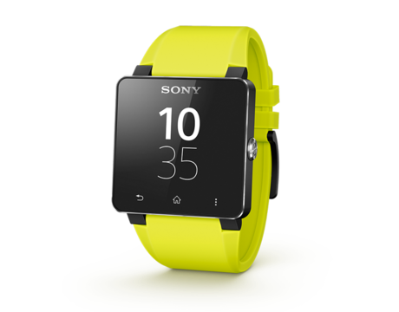
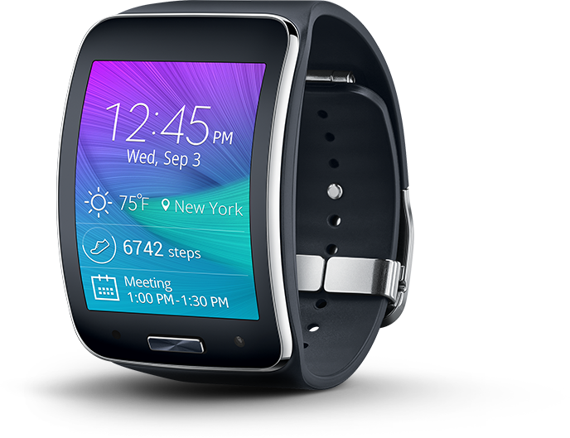
Mann, 1998
Various, 2015

Slide 7
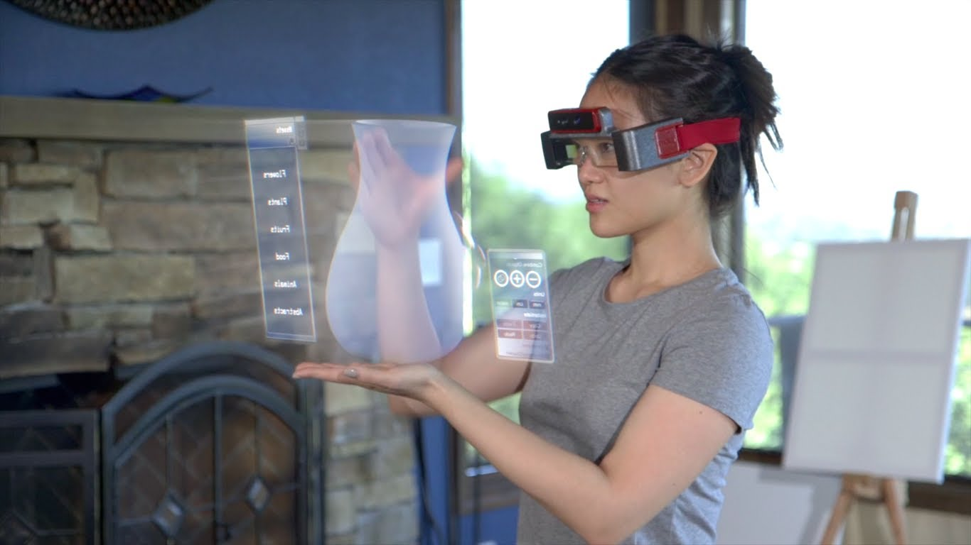


Slide 8



by

Slide 9
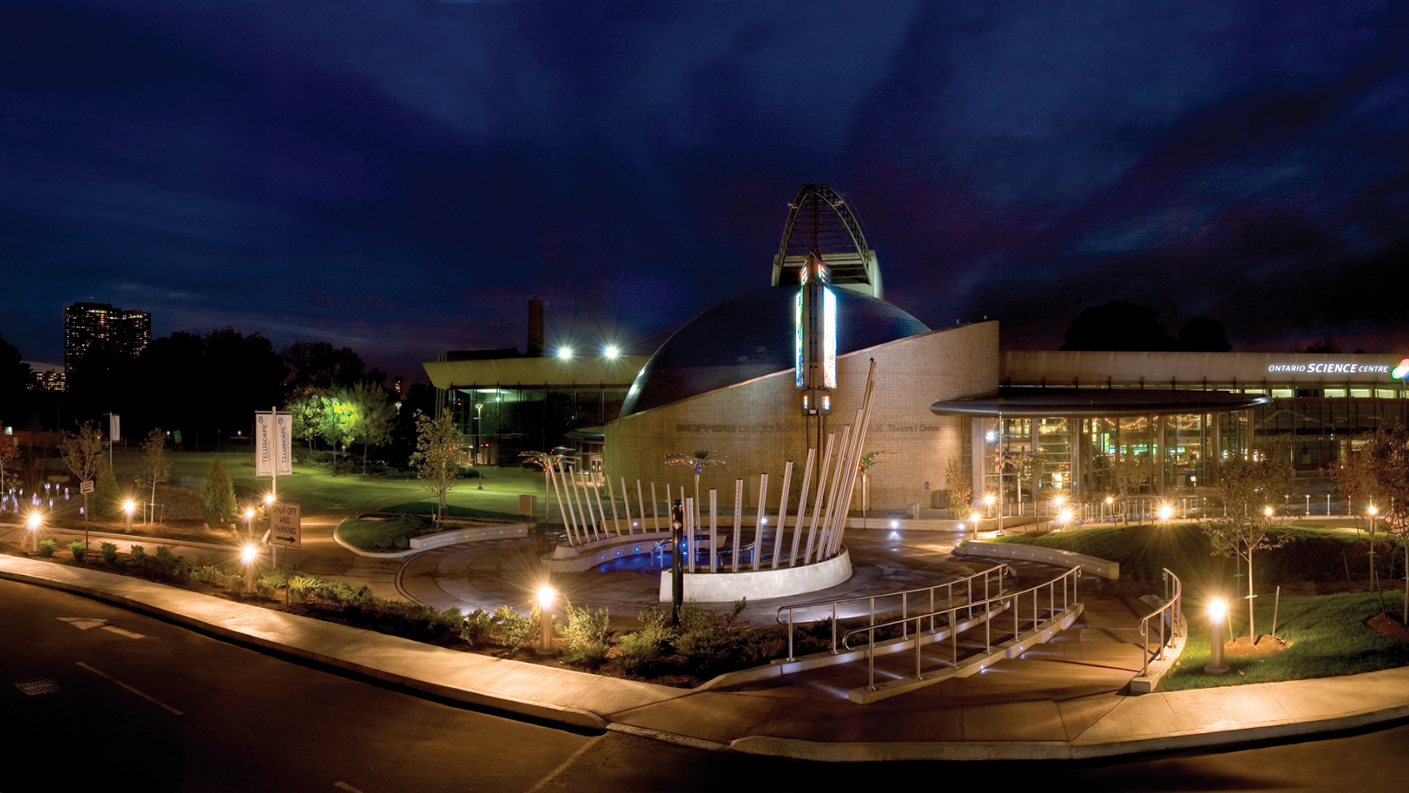
Hydraulophone
The world’s first instrument to make music from water
Photo: Copyright, Richard Picton

Slide 10
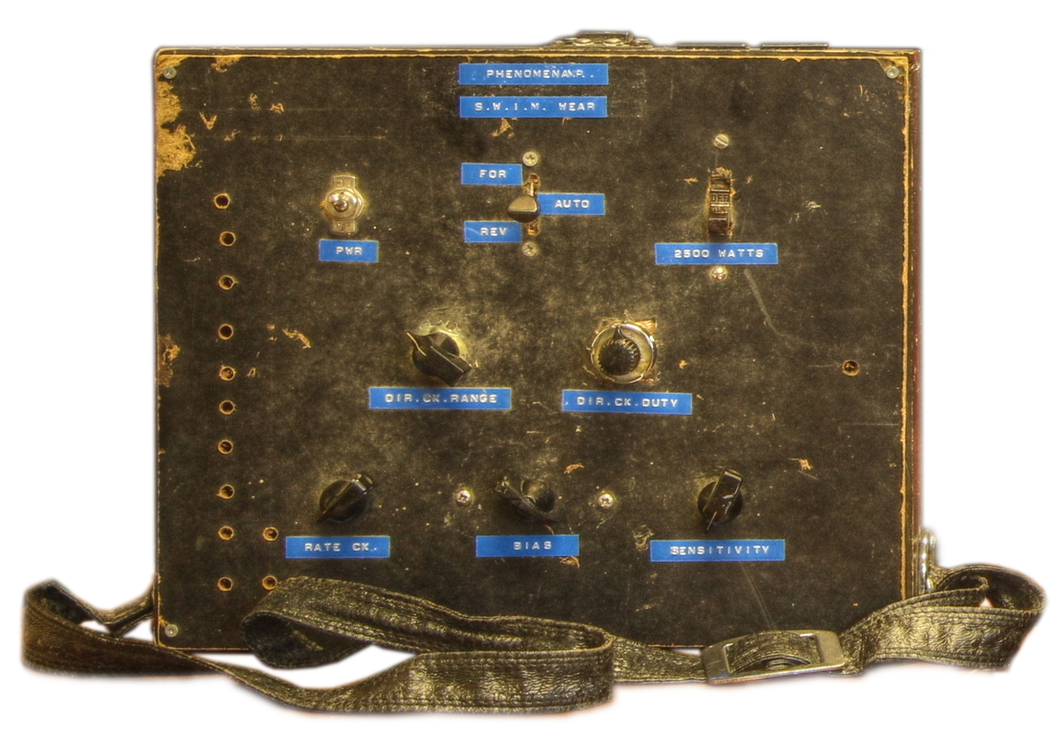

Slide 11
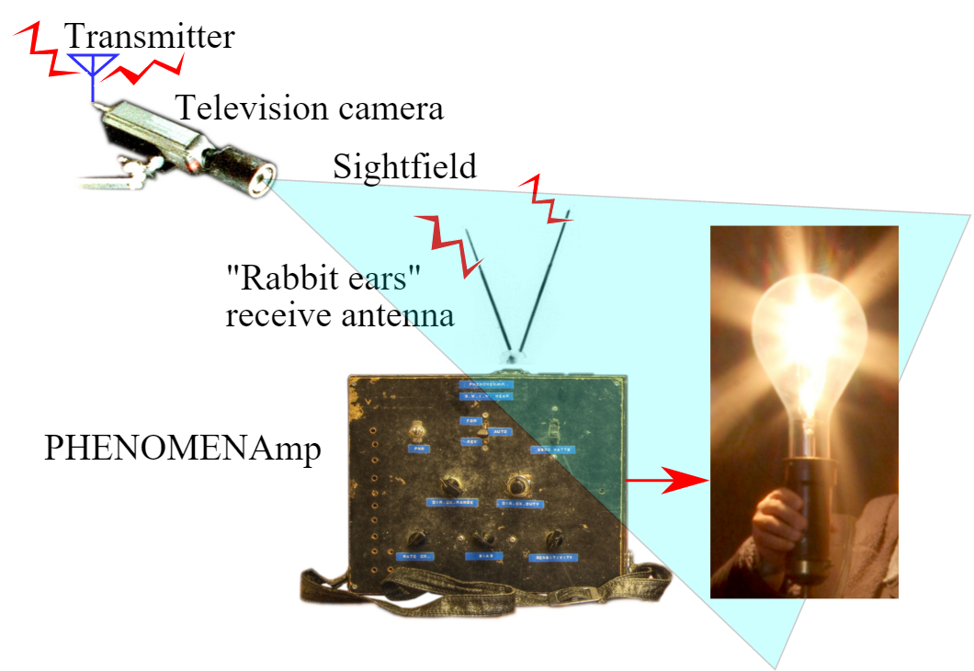

Slide 12


Slide 13


Slide 14


Slide 15

Standing Waves

Slide 16
Standing Waves vs. Sitting Waves

Slide 17
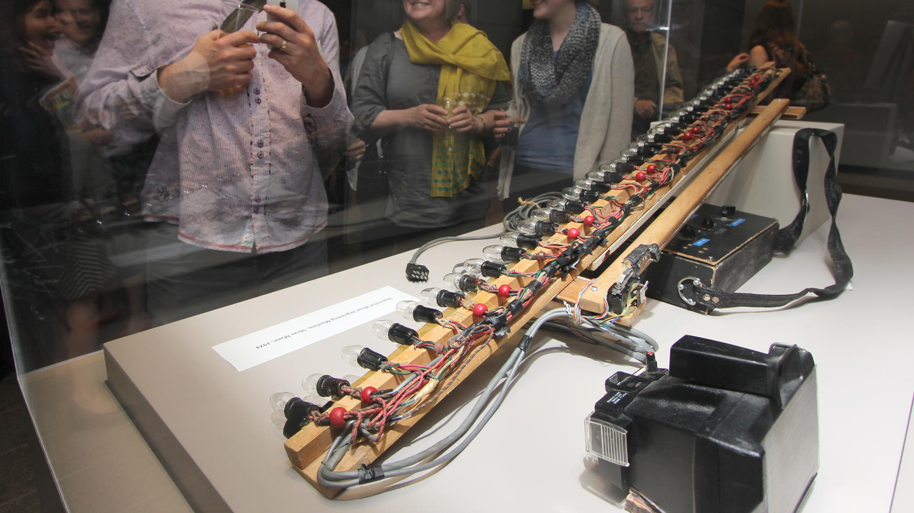

Slide 18
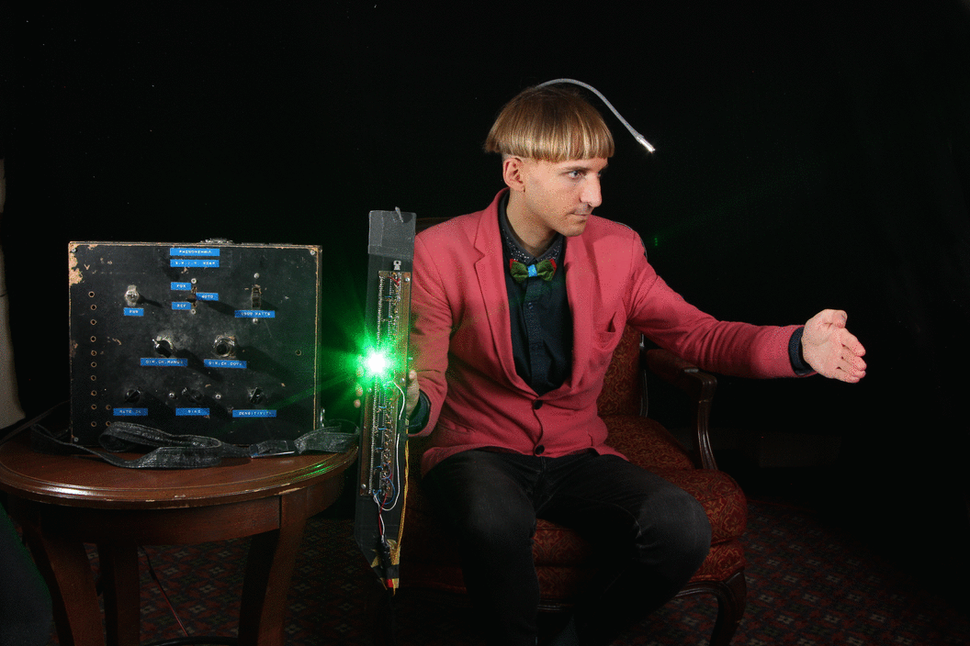

Slide 19


Slide 20


Slide 21
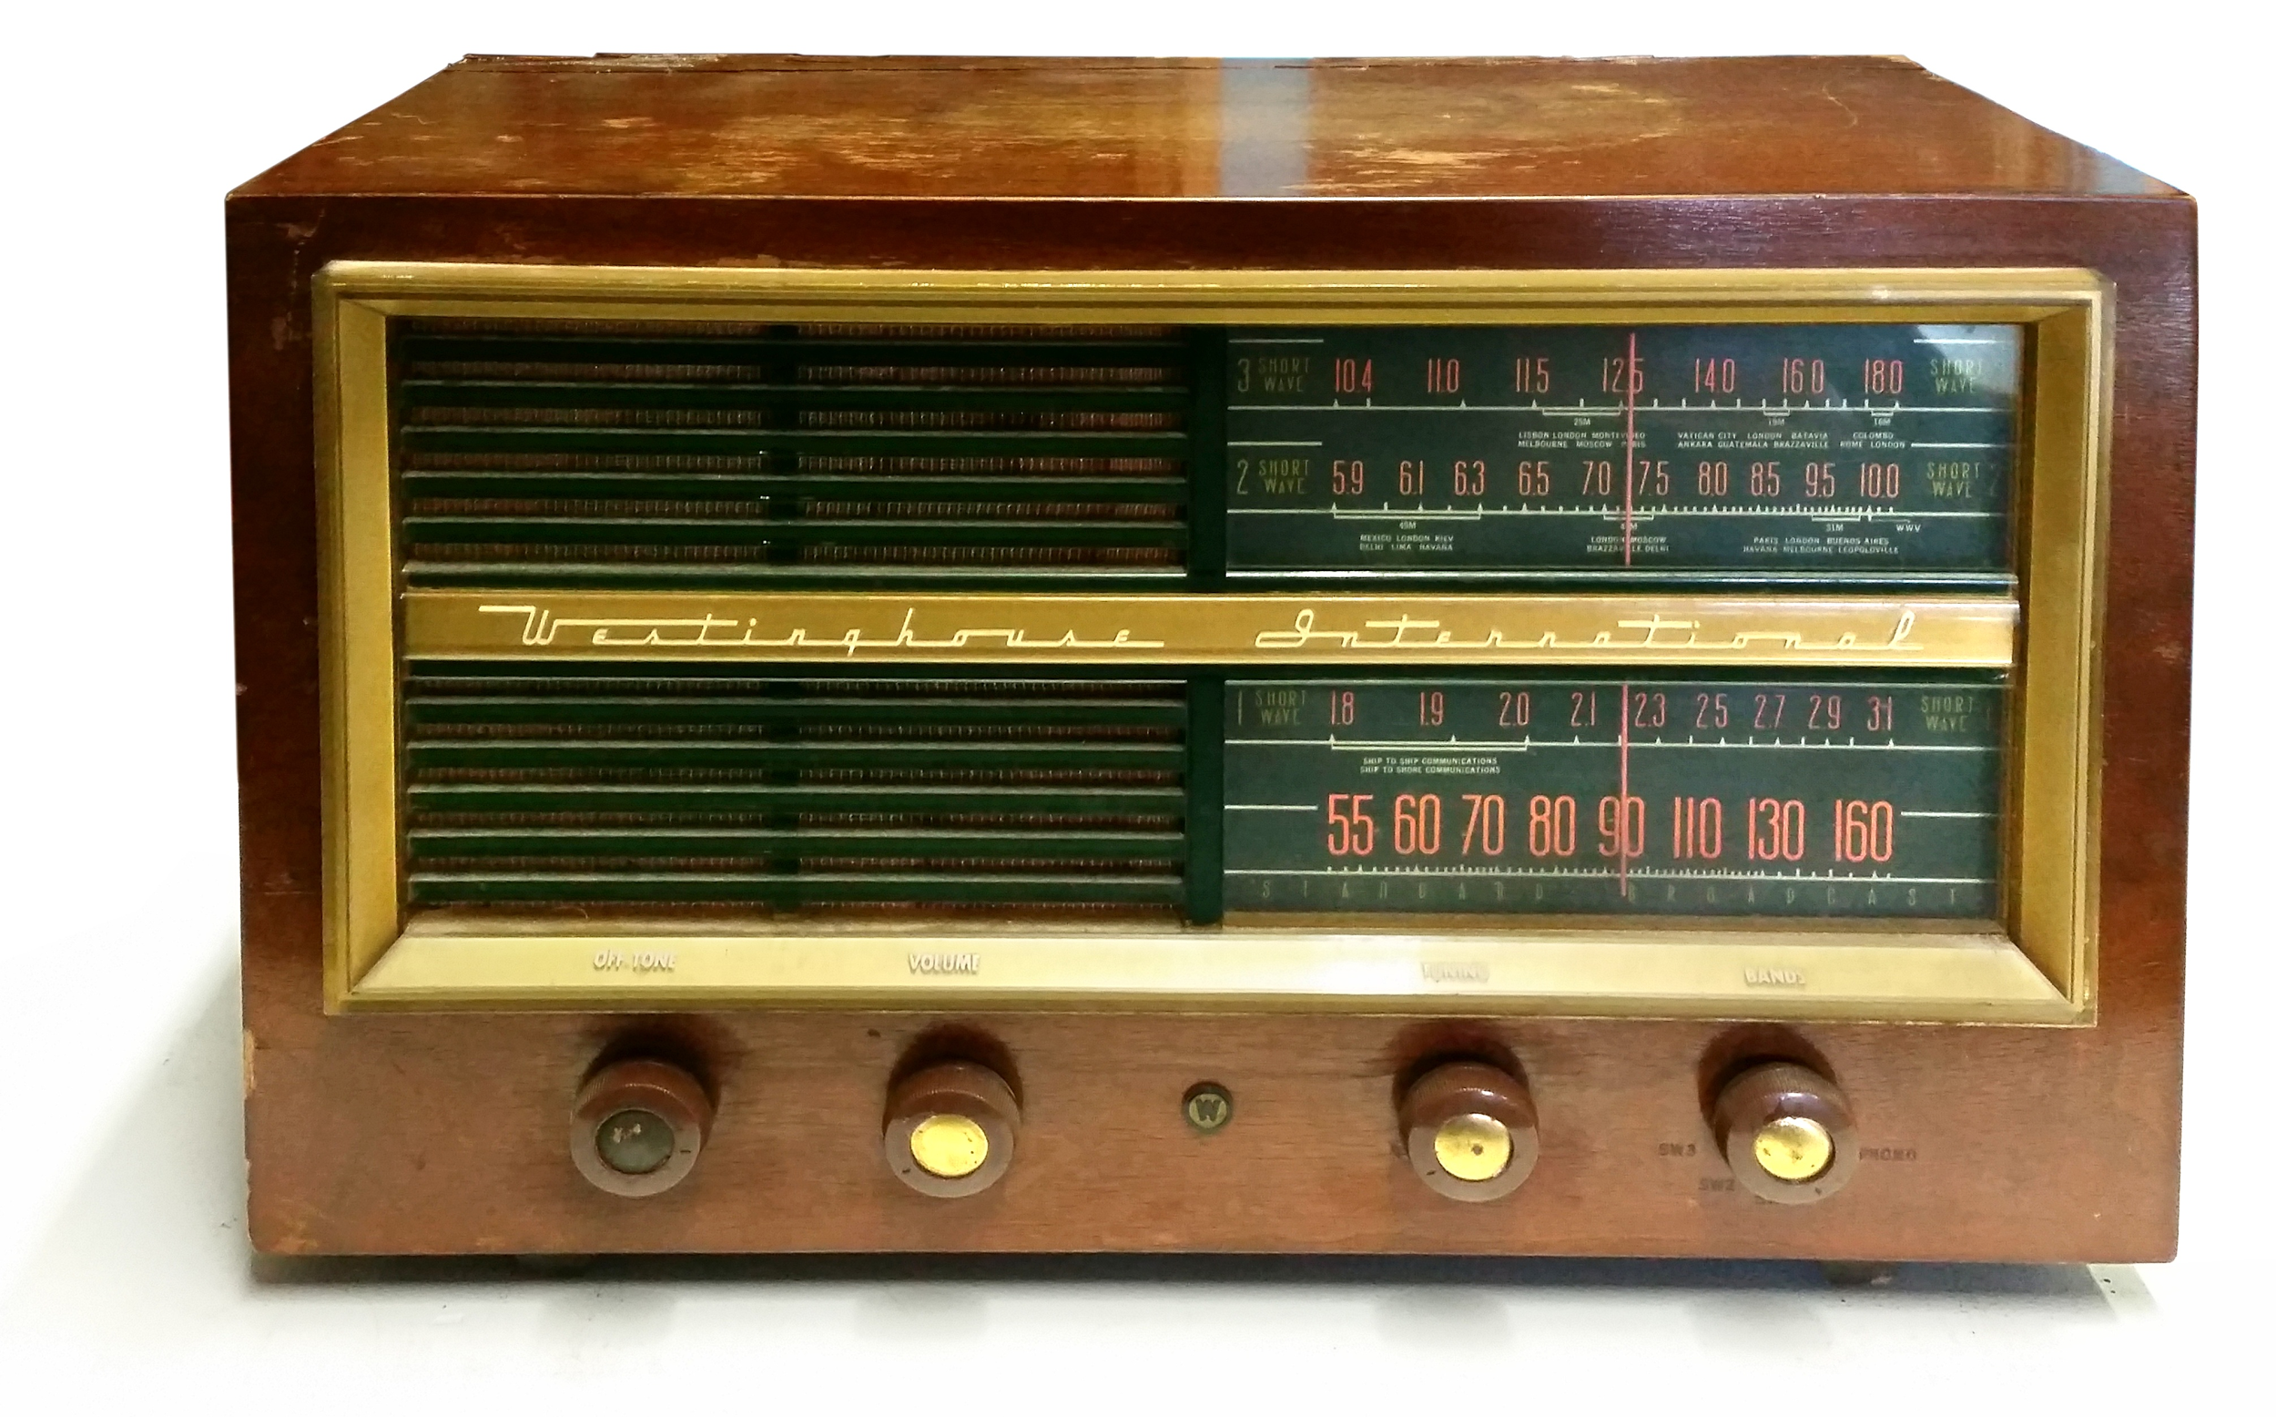

Slide 22


Slide 23


Slide 24
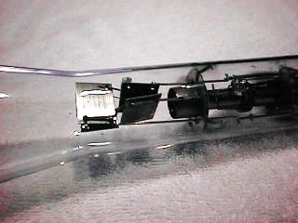

RCA906 CRT Pictures courtesy of Neil Heckt, who passed away on August 19, 2015.

Slide 25
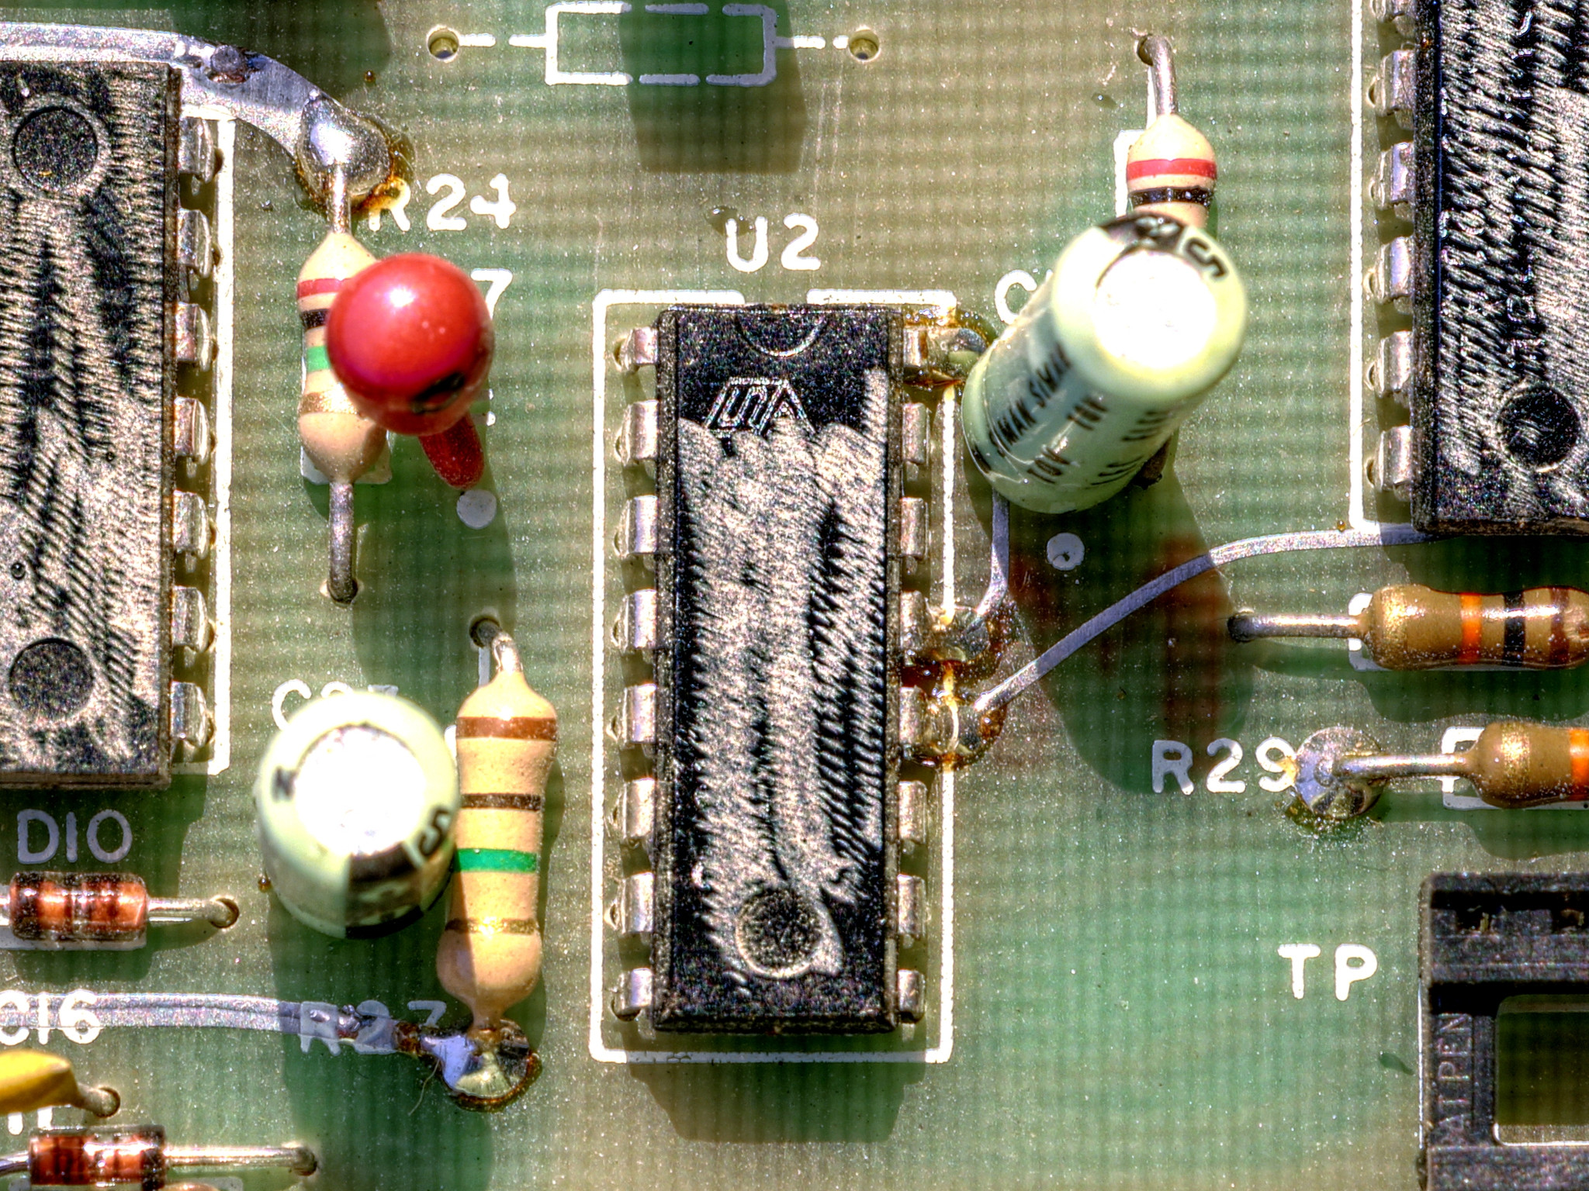

Slide 26



Slide 27
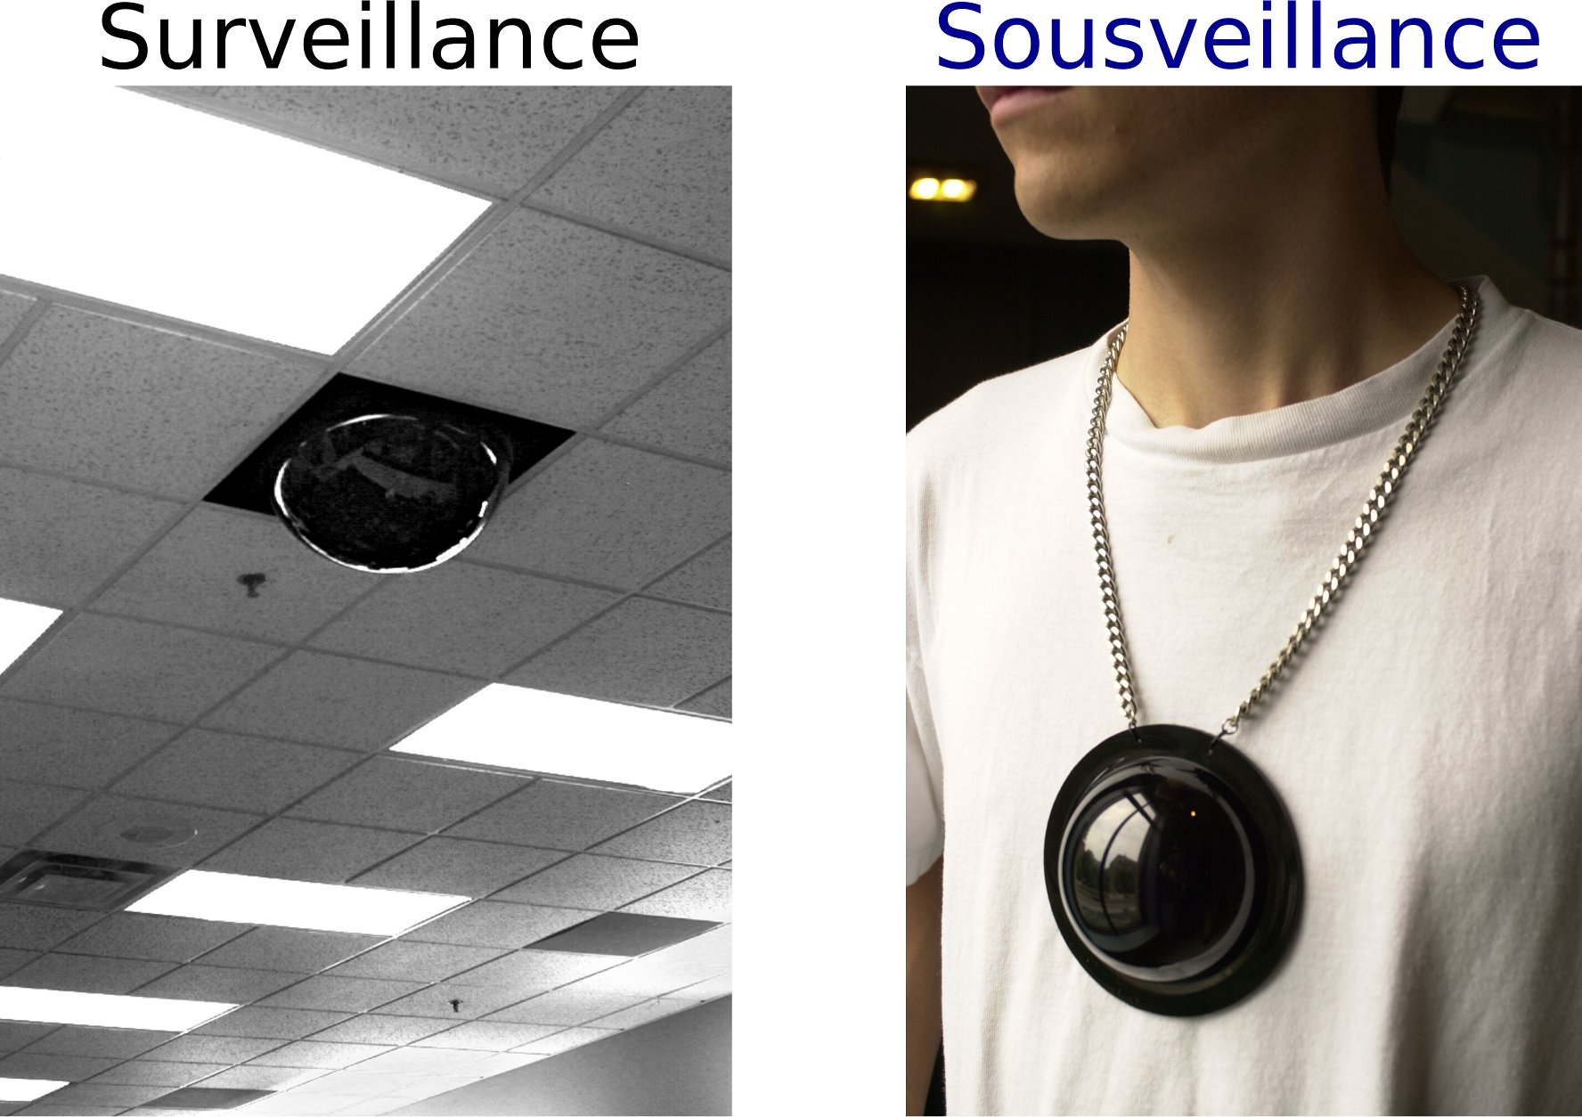

Slide 28
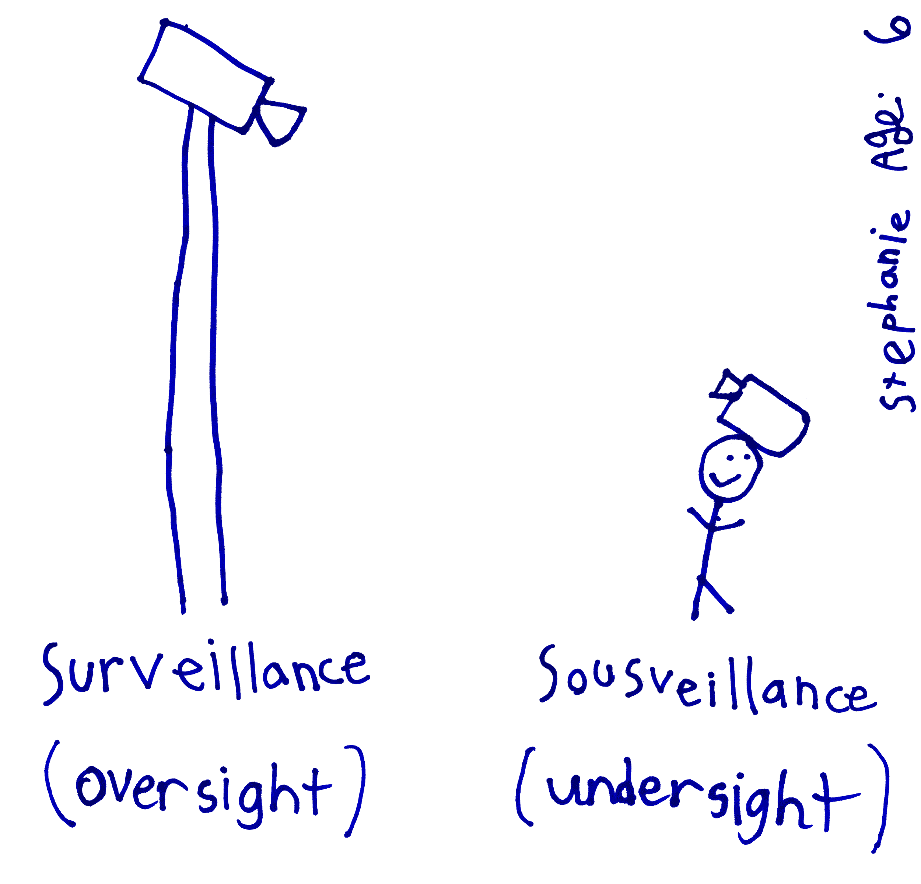

Slide 29
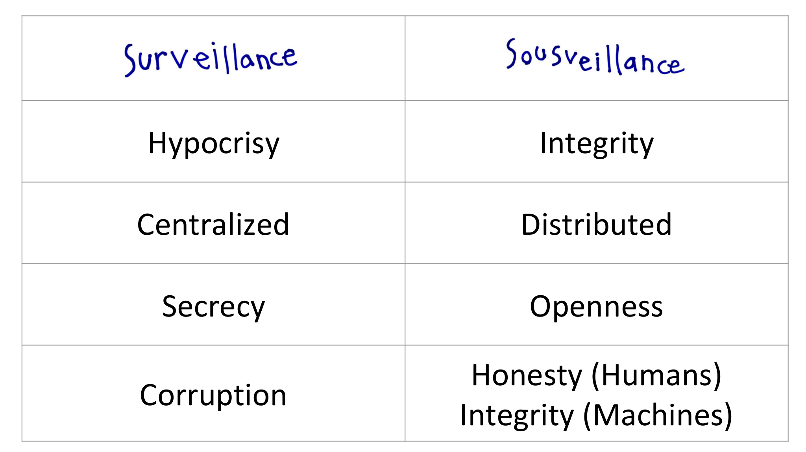

Slide 30
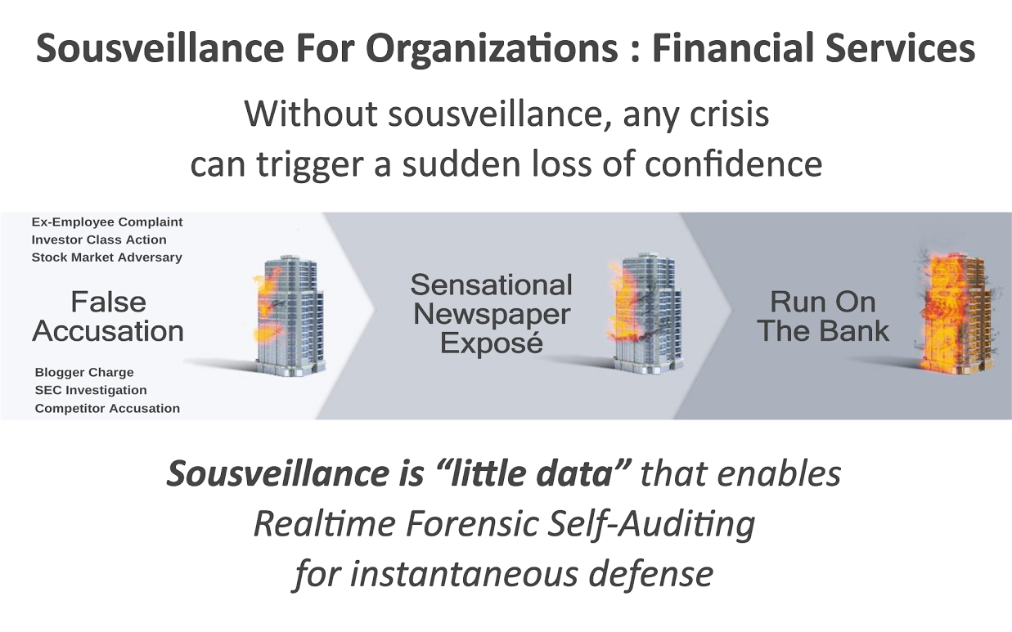

Slide 31
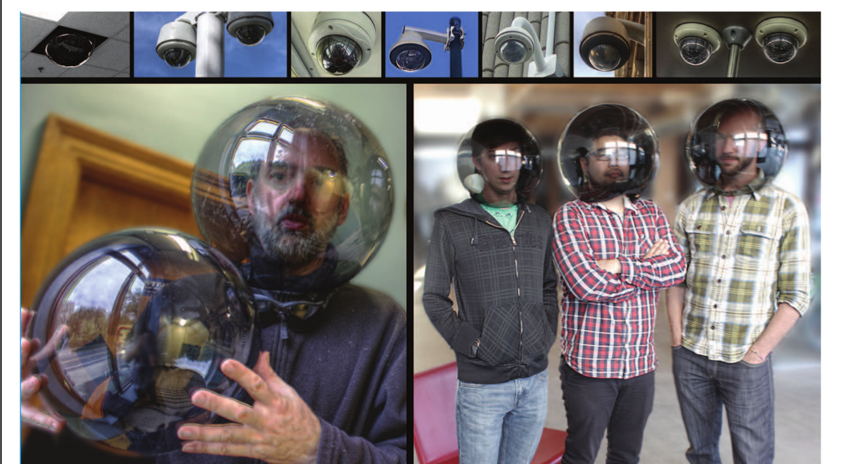

Slide 32
“[Humanistic intelligence is]… a technological framework for self- determination and mastery over one's own destiny… a new synergy between humans and computers… a true extension of the mind and body.”
— Steve Mann, 1997 paper on Wearable Computing [ISEA97]
“We believe AI should be an extension of individual human wills and, in the spirit of liberty, as broadly and evenly distributed as is possible safely.”
— OpenAI, December 11 2015 blog post

Slide 33
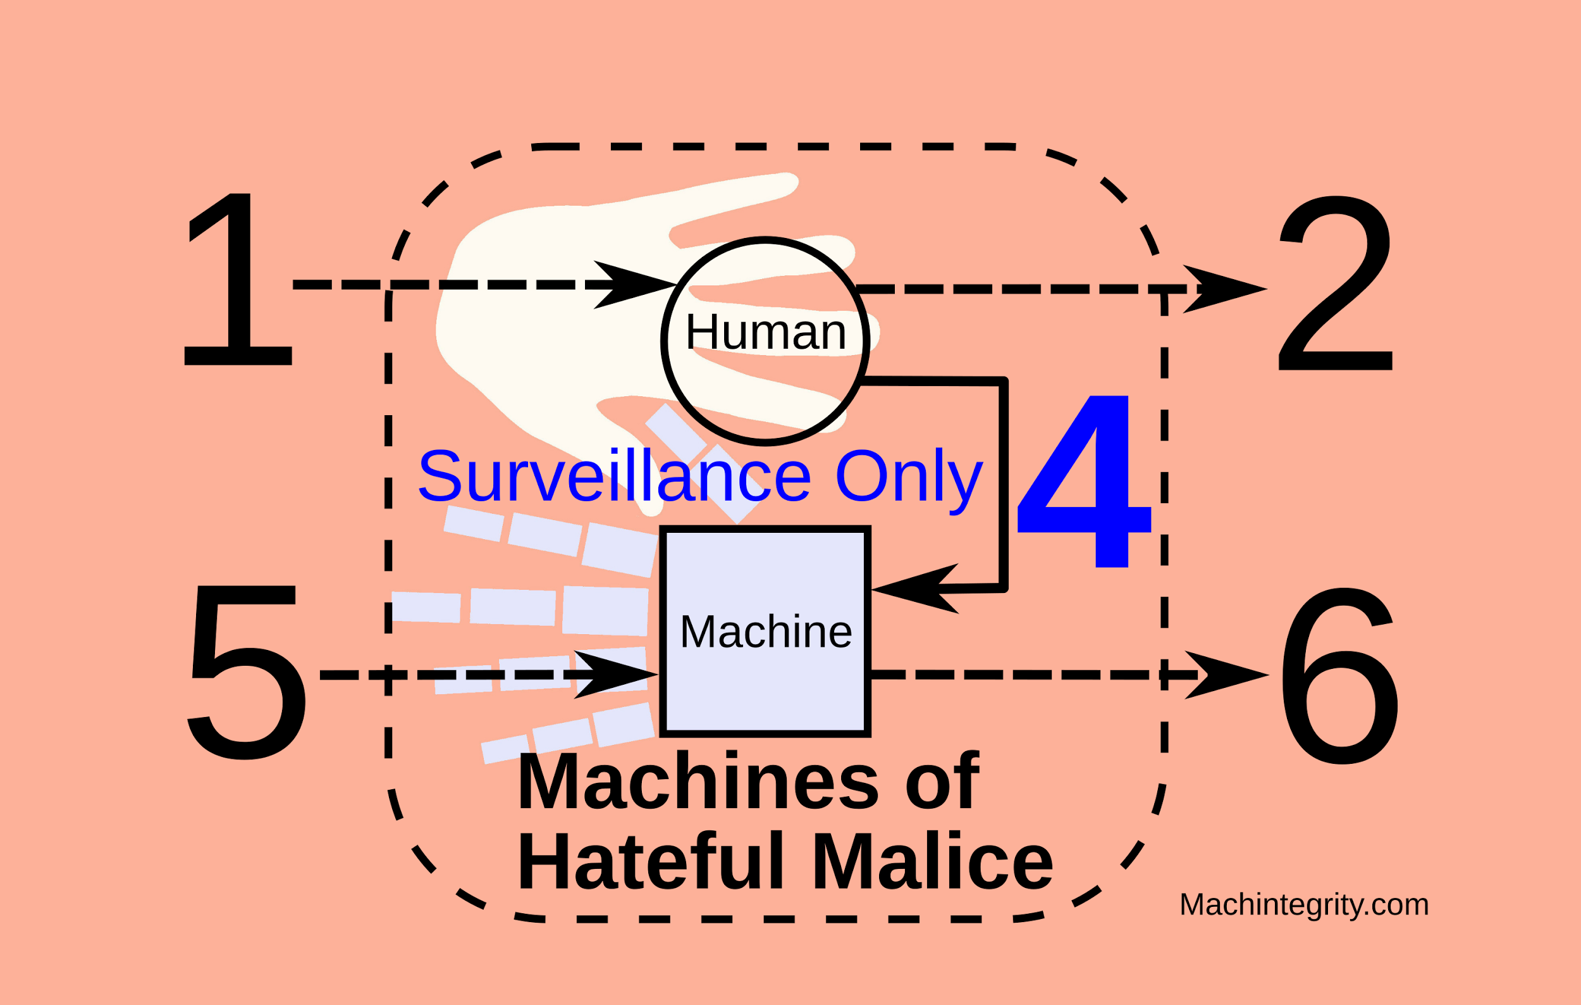

Slide 34
